Slide 1
Leadership Development as a Social Justice Strategy
Alexis Kanda-Olmstead
Director of Advancement Talent Management
Dartmouth College

Slide 2
Leadership and Identity
Woman
Person of Color

Slide 3
Just because I am, doesn’t mean I know.

Slide 4
Session Goals
Increase awareness and action
Develop leadership capacity
Identify strategies for change

Slide 5
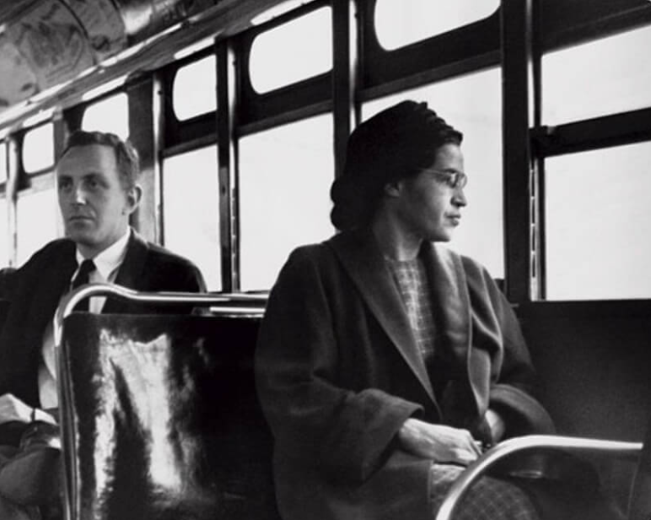

Slide 6
Fortune 500 Chief Executive Officers
There are fewer women than there are men named James.
Miller, C., Quealy, K., & Sanger-Katz, M. (2018, April 24). The top jobs where women are outnumbered by men named John.
Retrieved from: https://www.nytimes.com/interactive/2018/04/24/upshot/women-and-men-named-john.html

Slide 7
Fortune 500 Chief Executive Officers
2
Women of Color
Miller, C., Quealy, K., & Sanger-Katz, M. (2018, April 24). The top jobs where women are outnumbered by men named John.
Retrieved from: https://www.nytimes.com/interactive/2018/04/24/upshot/women-and-men-named-john.html

Slide 8
AFP membership is 70% female, but 4 out of 5 senior positions in fundraising are held by males.
Among CASE 50 Institutions, only 26% are headed by female Chief Advancement Officers.
2018 statistics reported by the Educational Advisory Board and the Association of Fundraising Professionals.

Slide 9
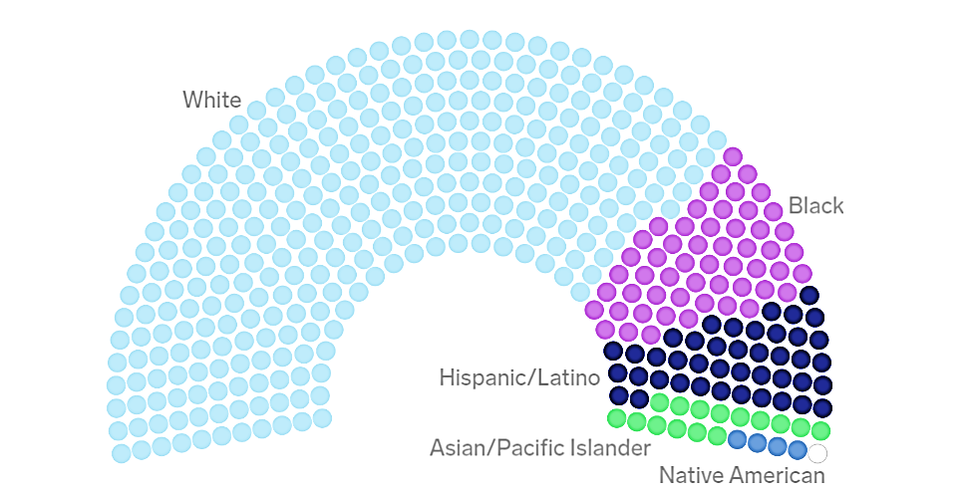
United States Congress
Whites make up larger share of Congress than of U.S. population
Pew Research Center

Slide 10
9 out of 10 nonprofit leaders are white - a number that’s not changed in a quarter century.

Slide 11
Agenda
Identity
Tools
Reframing

Slide 12
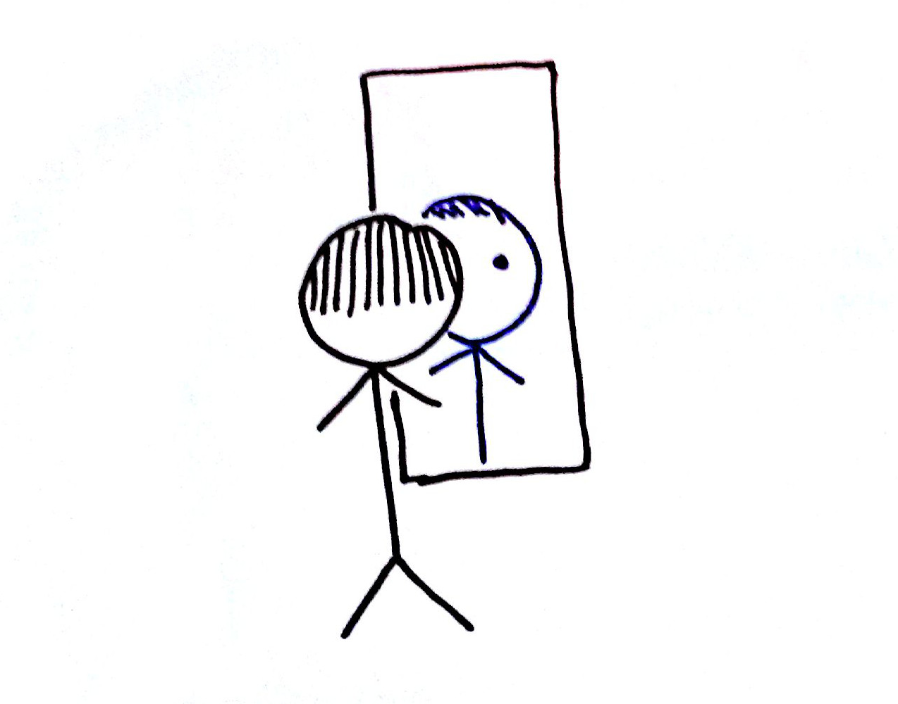
Identity
Imposter Syndrome
Stereotype Threat
Identity & Leadership

Slide 13
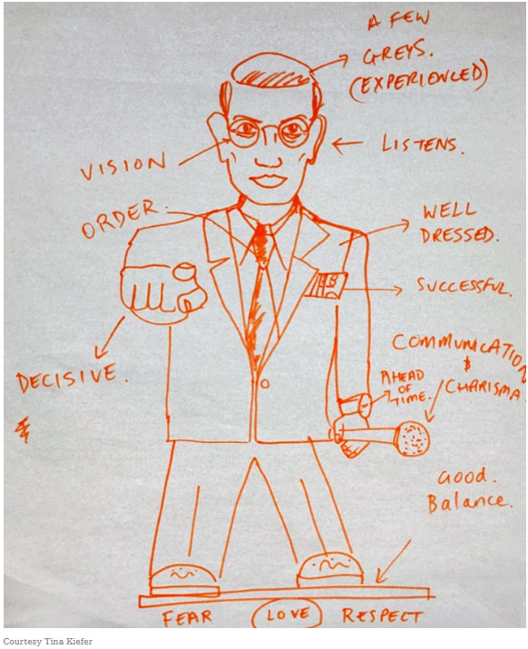
“Draw an effective leader.”
Brown, H. (2018, March 16). Picture an effective leader: Is she a woman?
Retrieved from: https://www.nytimes.com/2018/03/16/health/women-leadership-workplace.html?save=nyt-gateway-stories

Slide 14
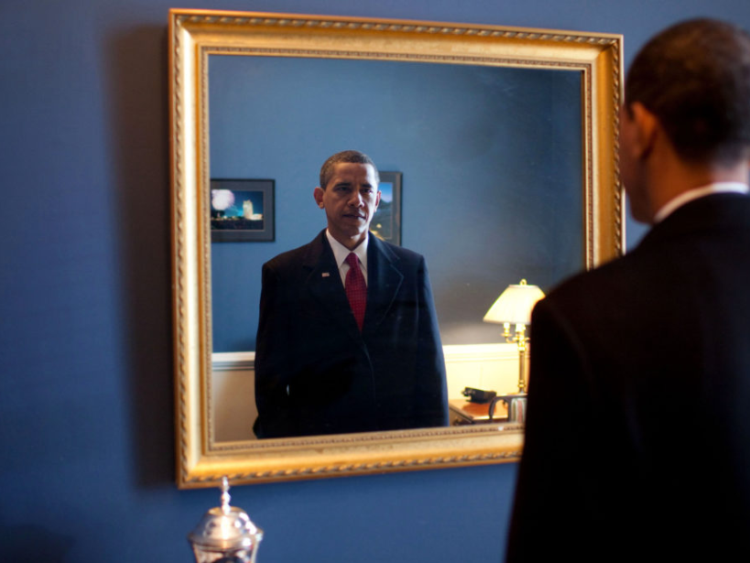

Slide 15
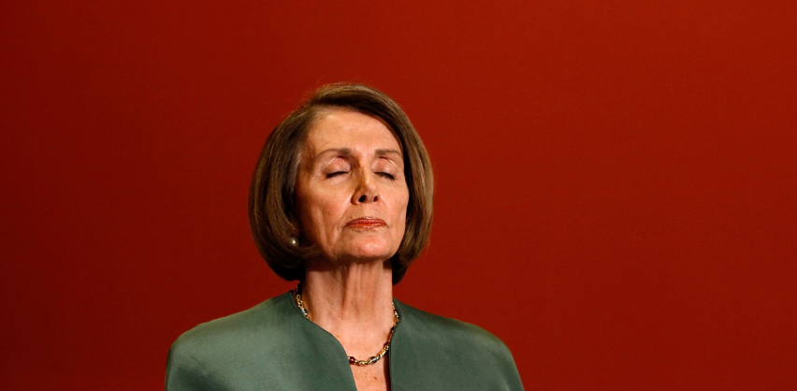
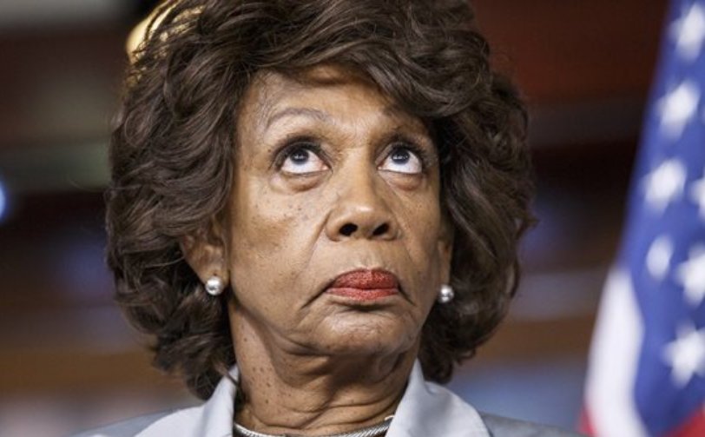
Speaker Nancy Pelosi: The Second Time as Farce
Thirteen Times Hilary Clinton Was a Truly “Nasty Woman”
Ocasio-Cortez's 'Green New Deal’ a Joke?
Is Rep. Maxine Waters Fit to Serve as Chair of House Financial Services Committee?

Slide 16
Imposter Syndrome
1 IN 3 GIRLS
WITH A GRADE POINT AVERAGE
ABOVE 4.0
DO NOT THINK THEY ARE SMART ENOUGH FOR THEIR DREAM CAREER
Hinkelman, L. (2017). The Girls’ Index: New insights into the complex world of today’s girls. Columbus, OH: Ruling Our eXperiences, Inc.

Slide 17
Stereotype Threat
Math abilities of young girls
Quantitative test results of female MBA students
GRE scores of black students
Athletic performance of white males
Steele, C. M. (2011). Whistling Vivaldi: And other clues to how stereotypes affect us (issues of our time). WW Norton & Company.

Slide 18
Diverse Leaders
Women
Democratic
Participative
People of color
Fairness
Integrity
LGBTQ
Adaptability
Embrace change
Eagly, A. H., & Chin, J. L. (2010). Diversity and leadership in a changing world. American psychologist, 65(3), 216.

Slide 19
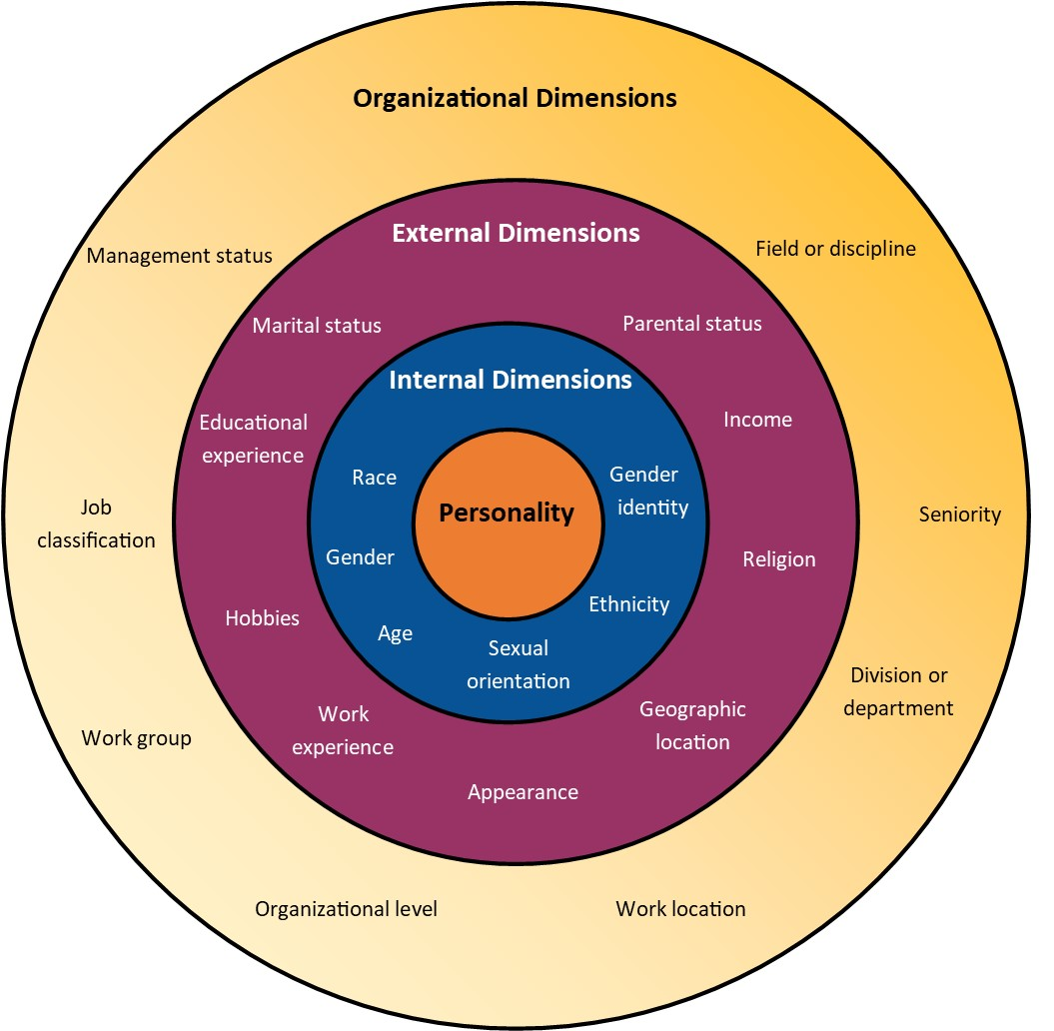
Diverse Leadership
What strengths have you developed as a result of your identities?
How have your identities influenced your values?
Gardenswartz, L., & Rowe, A. (1994). Diverse teams at work. Chicago: Irwin.

Slide 20
Agenda
Identity
Tools
Reframing

Slide 21
Reframing
Identity includes strengths and values
Action creates confidence
Leadership as a process, not a position

Slide 22
Leadership as a Process, Not a Position
Participant
Participant
Leader
Participant
Leader
Follower
Follower
Follower

Slide 23
When have you participated in the process of leadership?

Slide 24
Identity Includes Strengths and Values

Slide 25
What is one strength or value that is core to your identity?

Slide 26
What is one strength or value that is core to your identity?
Go to POLLEV.COM
Enter username DARTMOUTH
Select JOIN
Complete Survey
Identity Includes Strengths and Values

Slide 28
Confidence Myth
Competence + Confidence → Action
Action Creates Confidence

Slide 29
Confidence Myth
Competence + Confidence → Action
Competence + Action → Confidence
Action Creates Confidence

Slide 30
What actions can you take to build your confidence as a leader?

Slide 31
Agenda
Identity
Tools
Reframing

Slide 32
Tools
Identify with your strengths and values
Take action to build confidence
Engage in leadership as a process

Slide 33
The leader I see in you is someone who…

Slide 34
Questions

Slide 35
For Your Bookshelf
Katty, K. & Shipman, C. (2014). The confidence code: The science and art of self. HarperCollins Publishers.
Krawcheck, S. (2017). Own it: The power of women at work. Crown Business.
Steele, C. M. (2011). Whistling Vivaldi: And other clues to how stereotypes affect us (issues of our time). WW Norton & Company.
West, Cornel. Race matters, 25th anniversary: With a new introduction. Beacon Press, 2017.

Slide 36
Leadership Development as a Social Justice Strategy
Alexis Kanda-Olmstead
Director of Advancement Talent Management
Dartmouth College
Alexis.L.Kanda-Olmstead@Dartmouth.edu

