Slide 1
Leading without Formal Authority
Dr. Elizabeth Castillo
Arizona State University
October 3, 2019

Slide 2
Leading with Informal Authority Dr. Elizabeth Castillo
Session Overview
What is leadership? Busting some common myths
Strategies & caveats for exercising leadership via informal authority
Action steps to develop your leadership capacity

Slide 3
Leading with Informal Authority Dr. Elizabeth Castillo
What is Leadership?
the process of mobilizing people
to transform an existing reality
into a mutually beneficial future

Slide 4
Leading with Informal Authority Dr. Elizabeth Castillo
Common Leadership Myths
1. Leadership comes naturally, leaders are born
2. Management = leadership
3. Only certain people are leaders
4. Leadership is telling others what to do
5. Leaders have all the answers
6. Leadership requires positional authority (top dog)

Slide 5
Leading with Informal Authority Dr. Elizabeth Castillo
Common Leadership Myths
1. Leadership comes naturally, you have to be a born leader
FACT:
Leadership is a skill—it can be learned and developed

Slide 6
Leading with Informal Authority Dr. Elizabeth Castillo
Common Leadership Myths
2. Management = leadership
FACT:
Management seeks stability and risk reduction.
Leaders take calculated risks, embrace uncertainty.

Slide 7
Leading with Informal Authority Dr. Elizabeth Castillo
Common Leadership Myths
3. Only certain people are leaders
FACT:
Everyone can be a leader
we must lead ourselves (goals, self-regulation)
family leadership
volunteering and community leadership

Slide 8
Leading with Informal Authority Dr. Elizabeth Castillo
Common Leadership Myths
4. Leadership is telling others what to do
FACT:
Leaders activate potential, catalyze agency of others
encourage voluntary action rather than force/control
create process architecture for self-organization
don’t create followers, they create other leaders

Slide 9
Leading with Informal Authority Dr. Elizabeth Castillo
Common Leadership Myths
5. Leadership is having all the answers
FACT:
Leaders are ok with not knowing.
curious, comfortable with uncertainty
recognize & value expertise of others
co-create answers with stakeholders & the community

Slide 10
Leading with Informal Authority Dr. Elizabeth Castillo
Common Leadership Myths
6. Leadership requires positional authority (top dog)
FACT:
Leadership is a process, not a role
We can exercise leadership in any role using our informal authority (social influence)

Slide 11
Strategies & Caveats for Leading with Informal Authority

Slide 12
Leading with Informal Authority Dr. Elizabeth Castillo
Strategies for exercising leadership without positional power
Expand mental model of leadership: three frameworks
Distributed Leadership (Harris, 2008; Bolden 2011)
Activating collective intelligence, shared power, empowering others
Facilitative Leadership (Smith, 2003)
Help people make connections and meaning
Balance content and process
Adaptive Leadership (Heifetz & Linsky, 2002)
Mobilizing people to do adaptive (transformational) work

Slide 13
Leading with Informal Authority Dr. Elizabeth Castillo
Adaptive Leadership Vocabulary
Authority: Formal or informal power within a system, entrusted in exchange for a service. The basic functions provided by authorities are: (1) direction; (2) protection; and (3) order.
Formal authority: Explicit power granted to meet an explicit set of service expectations, such as those in job descriptions or legislative mandates.
Informal authority: Power granted implicitly
Intervention: Any series of actions or a particular action, including intentional inaction, aimed at mobilizing progress on adaptive challenges.
Source: Heifetz, R. Leadership without Easy Answers

Slide 14
Leading with Informal Authority Dr. Elizabeth Castillo
Strategies & Caveats for exercising leadership without positional power
Keep focus on PURPOSE—the end goal to which you are all working (mission)
Problem framing and reframing (Community Toolbox, 2019; Frameworks Institute)
Leading by asking questions (Marquardt, 2014)
Find allies, create alliances (Uzzi & Dunlap, 2012; Organizing for Power, 2009)
Build culture of learning and inquiry (Garvin, 1993)
Learn systems thinking (FSG, Gopal, & Preskill, 2016; Kim, 1999; Arnold & Wade, 2017)
Recognize & manage anxiety of your stakeholders (turn up heat, balance discomfort with stretching, monitor mood)
→ Self-reflection, self-care (for you and others)

Slide 15
Leading with Informal Authority Dr. Elizabeth Castillo
Problem framing exercise
You are the owner of an old, downtown office building.
Your tenants are complaining-- their employees are getting angry because of the long delay to get an elevator to the lobby at quitting time.
How do you solve this problem?

Slide 16
Leading with Informal Authority Dr. Elizabeth Castillo
Different framing → different approaches to solution
Flexible hours=too many people getting off work at same time
Faster elevators=the elevators are too slow
Bigger elevators=elevators not carrying enough people
More elevators=too few elevators
Playing music=wait is frustrating

Slide 17
Action Steps to Develop Your Leadership Capacity

Slide 18
Leading with Informal Authority Dr. Elizabeth Castillo
Action steps to develop your leadership capacity
Gain clarity! What is your personal mission statement? Why are you doing this work?
Know the issues in the nonprofit sector. Where are you getting your information?
What are you doing to build and sustain your network?
What is your plan for learning and growing—personally, professionally, organizationally?
How are you using your voice?
How are your creating space for discussion of shared values and collective action?

Slide 19
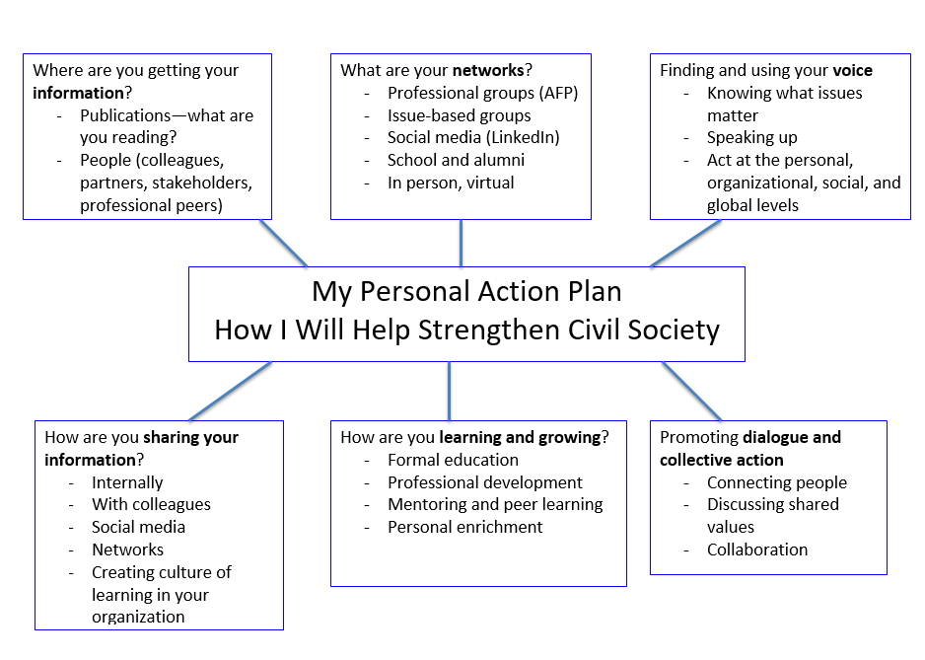
Leading with Informal Authority Dr. Elizabeth Castillo

Slide 20
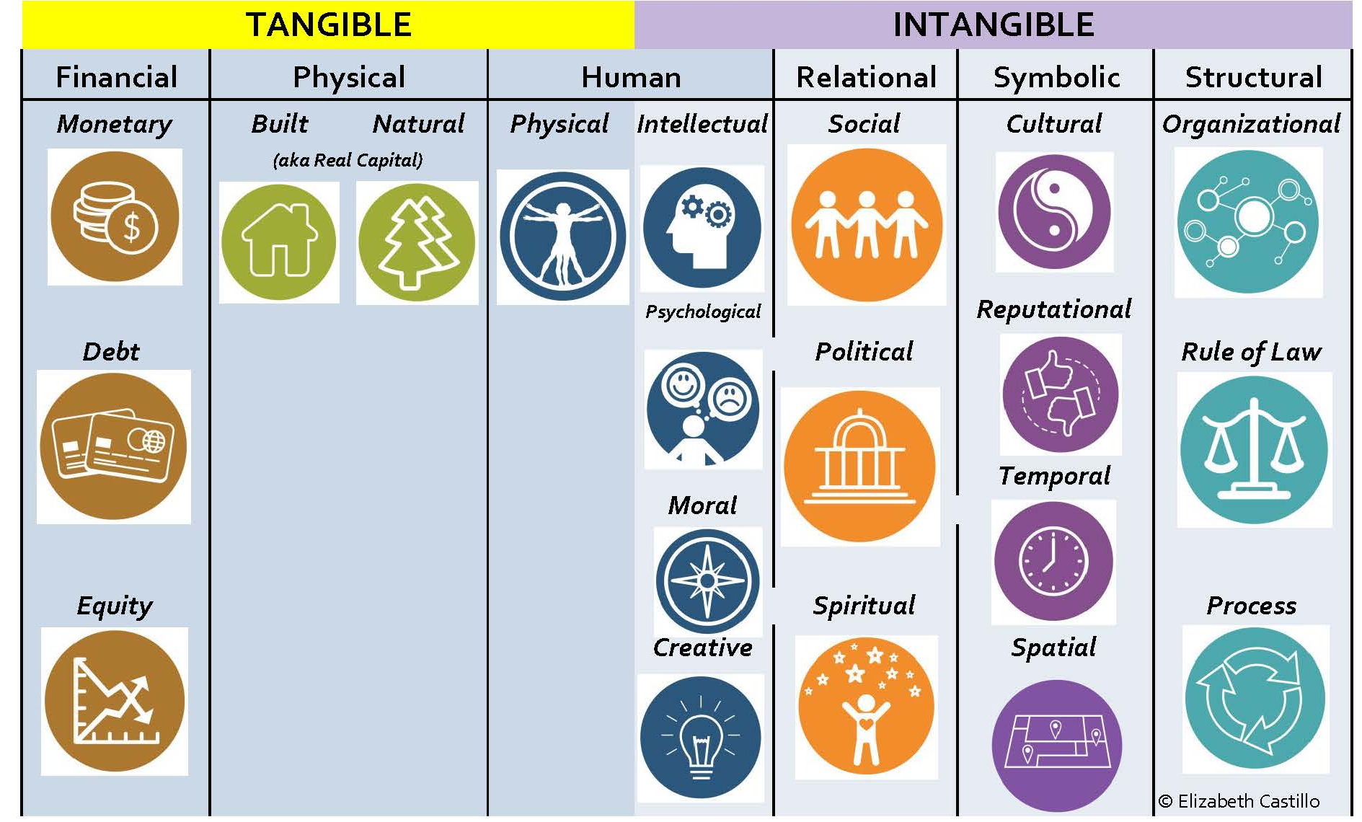
Leading with Informal Authority Dr. Elizabeth Castillo
A Resource Toolbox for Leaders (Castillo, 2016)

Slide 21
Leading with Informal Authority Dr. Elizabeth Castillo
Keep the Conversation Going!
LinkedIn Twitter
@eac_asu
https://www.linkedin.com/in/elizabeth-castillo-phd/

