Slide 1
Combating Imposter Syndrome When You Really Want to Go Home
Vinney Arora · vcarora@gmail.com Ann-Marie Meacham, MPA, CFRE · annmariemeacham@gmail.com Matthew Taylor-Siegel, CFRE · mtaylorsiegel@gmail.com

Slide 3
Introductions
or: How we learned to stop worrying and present this workshop
Notes:
Vinney
AMM
Matt

Slide 5
Imposter Syndrome Defined
or: How to understand that you aren’t alone
Notes:
Matt – 2 minutes

Slide 6
Famous Imposters
Notes:
Matt – 2 minutes

Slide 7
Let’s Get Warmed Up!
Notes:
Matt

Slide 8
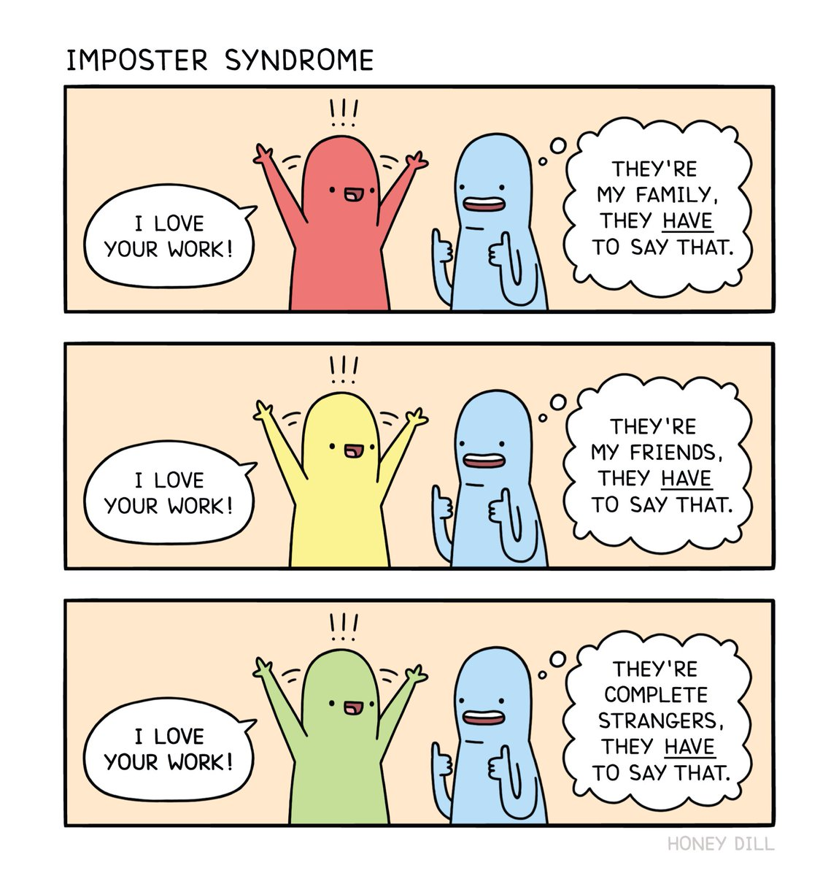

Slide 9
Using Imposter Syndrome to Your Advantage
or: How to turn your insecurities into strengths
Notes:
Matt – 2 minutes

Slide 10
Using Imposter Syndrome to Your Advantage
It’s a feature, not a bug
Dunning-Kruger
Comfort Zones
Notes:
Matt – 2 minutes

Slide 11
Dunning-Kruger Effect

Slide 12
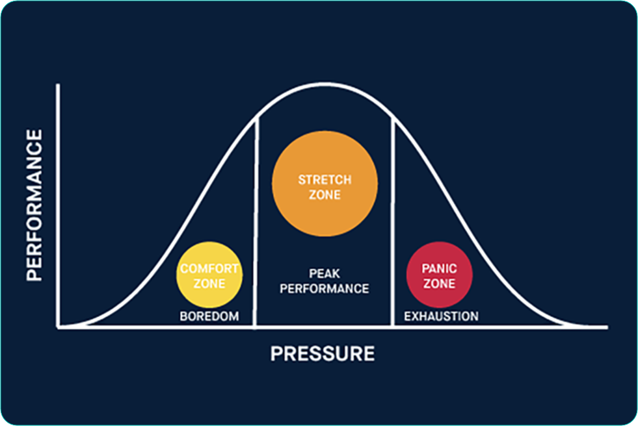

Slide 13
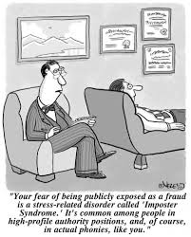

Slide 14
How Imposter Syndrome Can Manifest in the Workplace
or: How to navigate the land mines
Notes:
AMM – 10 minutes

Slide 16
Top 10 Ways You Can Overcome Imposter Syndrome
or: Appreciating your strengths
Notes:
AMM – 10 minutes

Slide 18
How to Destigmatize Imposter Syndrome
or: How to be an advocate
Notes:
Vinney – 10 minutes

Slide 20
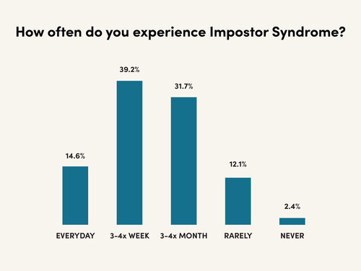

Slide 22
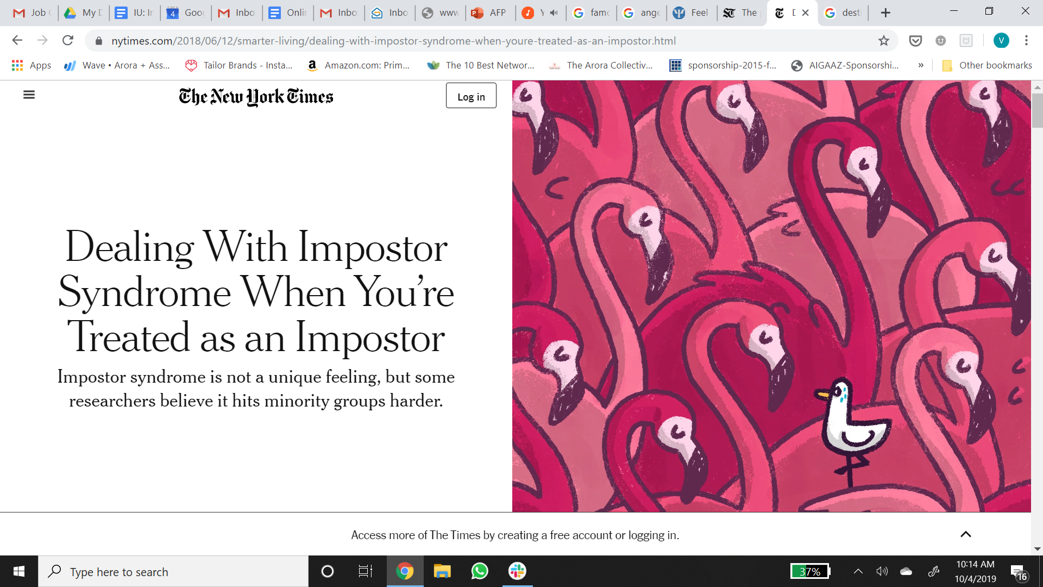

Slide 23
IT COULD'VE BEEN ANYBODY
IT WAS JUST LUCK
I JUST WORKED HARD
THEY'LL FIND
ME OUT
I'M A FRAUD

Slide 26
Questions?
Feedback or Ideas for each other?
What did you learn?
What will you try doing differently after this workshop?

Slide 27
Thank you!
Vinney Arora · vcarora@gmail.com Ann-Marie Meacham, MPA, CFRE · annmariemeacham@gmail.com Matthew Taylor-Siegel, CFRE · mtaylorsiegel@gmail.com
Notes:
Vinney – 10 minutes

