Slide 1

BE the CAUSE Webinar 2026
Notes:
Gretchen:
Hello!
Welcome to the AFP Foundation for Philanthropy BE the CAUSE Webinar for 2026, welcoming our new foundation development chairs!

Slide 2
Foundation Development Chair Orientation
Presented by:
Gretchen Gordon, CFRE, AFP Foundation for Philanthropy
Fundraising Board Chair-elect
Ann Hale, CFRE Interim Executive Vice President, Foundation Staff
Ayat Hassan, MBA Foundation Operations Director, Foundation Staff
February 26, 2026
Notes:
Gretchen
Read introductions and names
Both Ann and Ayat are available at any time to assist you and your chapter.
But just so you know specific roles. Ayat is the staff person responsible for the BE the CAUSE Campaign so she should be your first point of contact and who you will hear from the most.
Ann has the overall responsibility for the Foundation including our board governance and major gifts initiatives. But I am also always available to answer any questions that you may have.

Slide 3
Orientation Objectives
What is the AFP Foundation for Philanthropy?
  Impact
  Fundraising priorities
  Campaigns
BE the CAUSE: Foundation’s annual fund and our fundraising priority!
  What IS it?
  What does it do?
  How does it impact you?
Resources, responsibilities, and raising funds
Notes:
Gretchen
The objectives of this webinar are to:
Tell you about the Foundation for Philanthropy
1. What is the Foundation for Philanthropy and how is it different than AFP
2. Share the true impact of what the Foundation does
3. We want to be clear about our fundraising priorities, as well as our methods, for full transparency while working with you
Provide an overview of BE the CAUSE
BTC is the Foundation for Philanthropy’s annual fund
Supports so much of what we do – scholarships, grant backs, networking opportunities, professional development and more! We’ll go into detail later.
BE the CAUSE is one of the priorities of Foundation Development Chairs
Talk about your role and how we support you
What exactly is the role of the Foundation Development Chair?
What the Foundation does all year to provide you with support, resources, content and more!

Slide 4
What IS the AFP Foundation for Philanthropy?
The AFP Foundation enhances philanthropy and volunteerism
through programs of education, research and service that benefit
all those who lead, serve and support nonprofit institutions.
Notes:
Gretchen
What IS the Foundation for Philanthropy?
We are an independent 501 c(3)
AFP is a membership organization that is classified as a 501 (c) 6
We operate in tandem but we are a purely nonprofit organization that relies on donations to make impact in our profession
4. We do not fund any AFP operations.
5. No membership dues are used by the Foundation

Slide 5
Case for Support – The Foundation for Philanthropy’s Priorities
Growing Fundraising Leadership For a Better World
What does the Foundation support?
Leadership Development
IDEA (Inclusion, Diversity, Equity and Access)
Ethics
Research
Notes:
Ann
Tell you a bit about the Foundation’s priorities and our case for support. A couple of years ago, the Foundation developed a new Case for Support. Through that process, we identified four priority areas that support the Foundation’s mission to enhance philanthropy and volunteerism for the benefit of all those who lead, serve and support nonprofit institutions.
The priorities are:
Leadership Development
IDEA
Ethics
4. Research

Slide 6
AFP Foundation for Philanthropy
Leadership Development
Research
IDEA
Ethics
Scholarship
AFP Catalyst
LEAD
Diversity Scholarships
Mentoring Programs
Fundraising Effectiveness Project
Research Grants & Prizes
The next big issue
Ethics Month
Trust and Generosity
Notes:
Here is some detail for each of the pillars:
Leadership Development -- our Goal to Attract and Develop Fundraising Leaders is supported by several leadership development initiatives. AFP LEAD, (formerly Leadership Academy) is a Foundation-funded event for which we provide many scholarships. We also offer a Chamberlain Scholarships for AFP ICON to every chapter every single year so those individuals have an opportunity to attend the largest fundraising conference in the world and have educational, networking, and leadership development opportunities. We also have a new initiative called AFP Catalyst which is a program for senior leaders that took place for the first time at AFP ICON 2025.
Our work with Inclusion, Diversity, Equity and Access is really focused on building a Stronger Sector Through a More Diverse Workforce. Both AFP and the Foundation for Philanthropy have many initiatives that fall under the IDEA umbrella including our diverse communities scholarship program, and Diversity and WII mentorship programs that empower women and fundraisers from diverse backgrounds to gain important skills to advance in their careers. The Diverse Communities Scholarship Program was created by AFP and receives funding from the Foundation for Philanthropy to provide financial assistance for fundraisers who are themselves members of a diverse community or are employed by grassroots organizations that primarily serve diverse populations to attend the AFP International Conference on Fundraising. The Women’s Impact Initiative is the first initiative to assess, address and highlight the specific issues and challenges that women in the fundraising profession face, including pay equity, harassment, inclusion in leadership, and male allyship. The objectives are research, education, leadership development, implementation, and mentorship. The Alford Group IDEA Mentoring and Leadership Development Program was launched in 2019 and includes leadership development education, in person meeting opportunities at AFP LEAD, leadership topics and development webinars, cohort facilitated webinars, and executive coaching. The Foundation supports all of these IDEA efforts.
To support Research on Critical Issues in Fundraising the Foundation is funding research that supports the fundraising profession, such as the FEP, which provides vital data that helps all of us in the fundraising profession. The Research Council moved under the Foundation umbrella in 2022, and its work includes awarding the Skystone Partners Prize given to an author of a book that advances understanding of fundraising and philanthropy, and awarding multiple Bill Levis Research Grants each year for new academic research. In 2024, the Foundation received a $900,000 grant from the Fidelity Charitable Catalyst fund that is supporting much if this research work, as well as the development of a Donor Advised Fund Curriculum that will roll out in 16 AFP Chapters beginning this month.
And in alignment with the Foundation’s role as a catalyst for the nonprofit sector, we have been exploring the next big issue facing fundraisers and our sector. As a result of research conducted by the research council and also looking at the outcomes of AFP Catalyst, the Foundation has identified the issue of declining trust and its impact on the decline in giving as they key issue we will focus on now and in the future. In February, we held a convening of philanthropists to discuss the issues of trust and generosity and to identify what AFP’s role can be in helping to prepare fundraisers to combat these issues.
Ethics pillar is focused on helping to renew Public Trust in Charitable Organizations. This includes support of AFP Ethics Awareness Month that the Foundation helps to fund, largely through endowment funds. In addition, the work on trust and generosity fits under this pillar.

Slide 7
Our Fundraising Priorities
BE the CAUSE: our annual fund
Chapter IMPACT: our annual fund campaign to engage chapters
Major Gifts: one example is our Leadership Development program that is being created
Endowments: to fund scholarships and programs in perpetuity
Notes:
Ann: To support the mission, we have several fundraising priorities and strategies.
BTC is our annual fund, and we truly rely on help from our FDC’s to achieve our goals.
We also have the Chapter Impact program where the Foundation asks AFP Chapters to consider a gift from their budget to support the fundraising profession. Chapters can designate for a specific area of support or provide unrestricted funds for the Foundation to determine where the funds should be best directed. The areas of focus that the chapters can choose are Leadership development, IDEA, Chamberlain Scholarships, or Unrestricted. There is a $50 minimum gift to meet the 10-star requirements, and the chapter can make their gift via mail, email, over the phone, or online. The online link is on the BTC toolkit.
We also have a major gift program that we are working to grow. Major Gifts from individual, chapters, corporations, and foundations help to fund things such as the Leadership Development Program that was mentioned earlier.
I do want to take a quick moment to thank the chapters that have made major gifts – they are CA, Orange County, NYC, OH, Central, OH, Greater Cincinnati, Greater Atlanta and Greater Houston.
- And the foundation has many donors who make gifts that are endowed in perpetuity to help fund scholarships, Ethics Month, and other areas like ICON, LEAD, Ethics – whatever the donor is most passionate about.

Slide 8
What is BTC and what does it impact?
Scholarships: 290 were given out in 2025 alone! We support young professionals, diverse fundraisers and many more
Foundation Grant Back Program: a portion of the funds raised goes DIRECTLY back to your chapter – so you can make an impact in your community while also supporting the entire profession
Notes:
Ann – So what is the BTC and what does it impact?
As mentioned previously, BTC is Our annual fund
Supports scholarships for young professionals, diverse fundraisers, first time ICON attendees, and many more.
In 2025 we provided a total of 290 scholarships to AFP members. That includes:
113 Chamberlain Scholars (first-time conference attendees to the AFP ICON)
161 Diverse Communities and Blackbaud Diversity Scholars to the AFP ICON and LEAD
4 Collegiate Scholars funded by Marjorie K. & Stephen M. Levy
12 Scholarships for AFP ICON through the AFP/Alford Group Women’s Mentoring Program
It also supports the chapter Grant Back program: a portion of the funds raised goes DIRECTLY back to your chapter – so you can make an impact in your community while also supporting the entire profession
We’ll go into greater detail about these later
So why is it important to support this campaign? Because BTC positively impacts AFP members, your local communities, the entire profession and YOU through programs that help fundraisers to be better able to serve the nonprofits they work for and also their local communities.

Slide 9
2025 BE the CAUSE Campaign Highlights
$305,488 raised in 2025
Thank you all for a successful year!
Notes:
Ann
Before we talk about the 2026 campaign, I want to thank all of the chapters that participated in 2025. It was a successful year thanks to your efforts to encourage support from Chapter members.
Last year, BTC raised $305,488 overall for the Foundation.
BTC total giving was 87.3% of our goal and was basically flat over the previous year.
We/Ayat are going to talk about this later in the presentation.

Slide 10
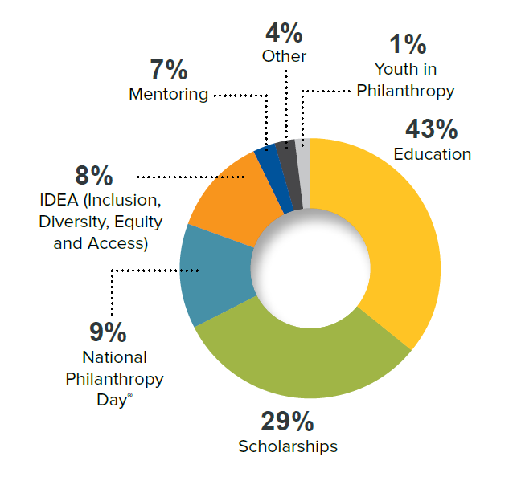
2025 Foundation Grant Back Usage
Notes:
Ann
It’s because of the fundraising that happens at the chapter level that we are able to achieve this level of fundraising. Therefore we feel that it is important to us to reward all of your hard work, so as I mentioned previously we ensure that a portion of BTC funds raised go directly back to your chapters to provide local impact through our incentive grant back program. You can see here how chapters utilized the funds granted back last year.
Further along in our orientation we will explain how your chapter can receive your grant back in 2026 for your 2025 efforts.

Slide 11




Foundation Initiatives
The AFP Foundation for Philanthropy strengthens the sector
through four key initiatives:
1
Support Research on Critical Issues in Fundraising
2
Attract and Develop Fundraising Leaders
3
Strengthen the Sector Through a More Diverse Workforce
4
Enhance Public Trust
in Nonprofit Organizations
Notes:
Ann
I know that it is very important that you have a case for support as you ask your chapter members to consider giving to the AFP Foundation. So just as a reminder, gifts made to BTC go to support the key initiatives of the Foundation – all of which help fundraisers to grow in their professions and expertise, increase impact in the organizations and communities they serve, and strengthen our sector.

Slide 12
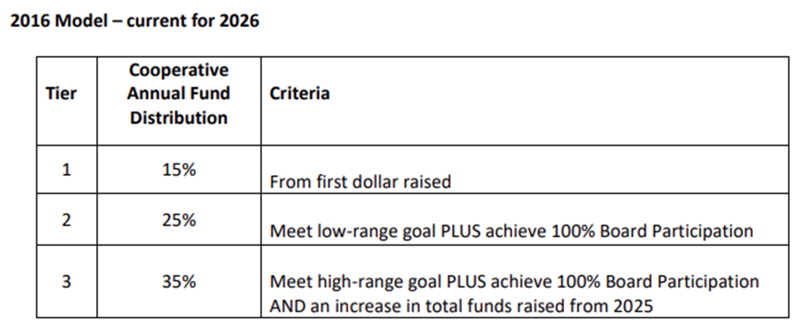
BE the CAUSE Grant Back Program
Notes:
Ayat:
All chapter leaders should have received an email from me in early February with your chapters new 2026 proposed low and high goals, a copy of your chapters 2025 chapter tally report, and a 2025 Grant Back form.
The Grant Back program is a grant that is given back to the chapters based on their low and high goal as well as 100% Board participation of the prior year. Every participating chapter receives either 15, 25, or 35% back of the BE the CAUSE dollars raised in the previous year.
This grant is to be used to fund chapter activities like Education, scholarship, National Philanthropy Day activities, Youth in Philanthropy programs, Diversity programs, Mentoring programs, or any activities that will advance ethical and effective fundraising
And here you can see all the criteria that must be met in order to receive each percentage back

Slide 13
Foundation Development Chair (FDC)
Also known as the BE the CAUSE Campaign Chair
Main Responsibilities: Educate, cultivate, solicit, and steward
Key Tasks: Recruiting, recognizing donors, communication, educating chapter leaders, and coordinating the campaign's efforts.
Make a personally meaningful gift to the BE the CAUSE campaign
Notes:
Ayat- The Foundation Development Chair (FDC) acts as a liaison between the chapter and the AFP Foundation for Philanthropy. This position is also known as the BE the CAUSE Chair
The FDC's main responsibilities are to educate, cultivate, solicit, and steward individual donors for the foundations annual campaign, specifically the BE the CAUSE Campaign.
Key tasks include recruiting committee members, recognizing donors, communicating the campaign’s value, educating chapter leaders, and coordinating the campaign's efforts.
The FDC also motivates members to support the campaign, monitors progress, resolves donor discrepancies, and reports regularly to chapter leaders.
Additionally, the FDC is encouraged to make a personal donation, share chapter stories that reflect its mission, and maintain active engagement with AFP Foundation staff. The role also involves sharing fundraising strategies, contributing messaging for the campaign, and ensuring a smooth transition by passing on records to the successor.
If you would like to read through The FDC description, it can be found on the BTC toolkit.

Slide 14
2026 BE the CAUSE Resources and Tool Kit
https://afpglobal.org/USFoundation/be-cause-campaign-toolkit#toolkit
Notes:
Ayat:
Everything you need to have a successful 2026 BTC campaign year can be found on the BTC tool kit. (Click)
Here you will find information on the foundation like our impact statement, the Foundation Development Chair Job Description, our code of ethics, donor bill of rights, and FAQ.
You will also find all gift/pledge forms like the chapter IMPACT form, the BTC form, and the 100% Board participation form.
Under the BE the CAUSE Campaign Materials title you will see the Foundations important dates and deadlines, our giving levels, as well as the Donor Pin Order form which the Foundation provides for free to the chapters.
And all the way at the bottom your chapter can now make a 2026 unrestricted chapter IMPACT gift. There is no need to log in! Click link
The Toolkit has a wealth of information for everything you need to know so I highly recommend bookmarking this site.

Slide 15
Database & Reports
No Login Gift Giving
Text AFP to 571-749-2699
New way to access the Chapter Tally reports
Notes:
Ayat
We have multiple ways anyone can make a gift online without having to log in!
Engage by Cell has extended their in-kind gift so we will continue to have the text option. We were able to work with give by cell to add a chapter designation field to assure that every gift will be credited
Chapter leaders should now have access to the tally report If you are having any issues viewing the tally report please contact me directly.
If a new gift comes in it will take a few hours to refresh the report
Ann and I are here to help any way possible. We want to see your chapter succeed!

Slide 16
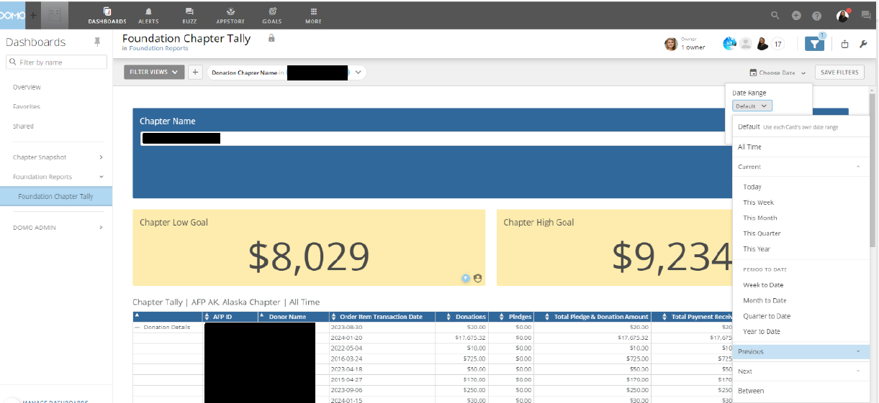
Notes:
Here is just a recap on how to pull your chapter reports.
Filer by Date

Slide 17
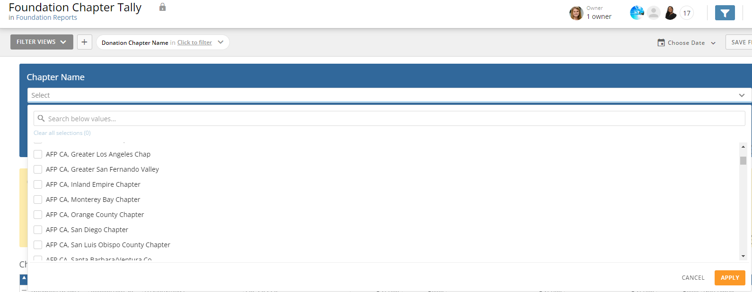
Notes:
If you are and admin or FDC for multiple chapters you can select each chapter

Slide 18
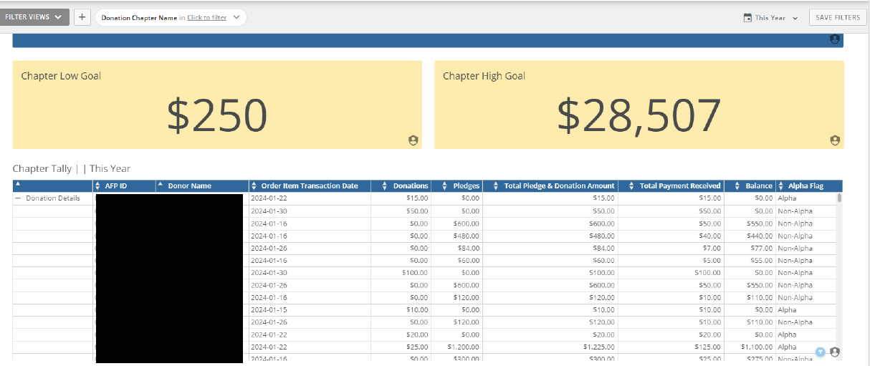
Notes:
Low and high goal (explain the low and high goals and how we come up with the goals and that we are happy to work with the chapter please contact me)
Donor ID
Name
Transaction date of last pledge or gift
Amounts
Alpha

Slide 19
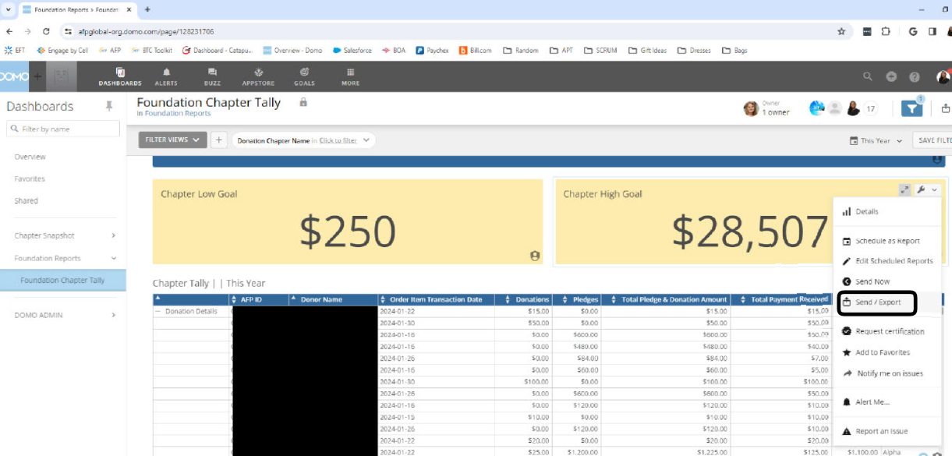
Notes:
Export files
Instructions are on the BTC toolkit and if you are having issues, please don’t hesitate to reach out to me.

Slide 20


How does the Foundation support your work?
Donor Acknowledgment Policy
Stewardship
  Gift processing/thank you letters
  Pledge reminders
  Renewal letters
  Donor Pins
Catapult Calling Program
Text to Give
Text AFP to 571-749-2699
Notes:
Ayat:
Just a few things that the foundation does to support you and your chapter:
We handle gift processing and acknowledgement
We send pledge reminders
We send renewal letters
As stated in the previous screen we also Provide donor pins and much more
The Catapult calling programs is an in kind gift from Catapult Fundraising. They called 4,000 lapsed donors from 2024-2025, this started October 2025. All gifts made in 2025 were credited to the 2025 BTC Campaign, and those gifts made in 2026 are being credited to the 2026 BTC Campaign.
Engage by Cell will continue partnering with us by providing a mobile giving platform to the Foundation for mobile giving all year long. TEXT AFP to 571-749-2699

Slide 21
What Can You Do for Your Donors/Prospects?
Solicit chapter board members to reach 100% Board Participation (10 Star!)
Virtual donor reception
Recognize BTC donors at chapter educational events / National Philanthropy Day, etc.
Send thank you emails to donors each month
Engage board members to personally solicit members to make/upgrade gift
Profile your Chamberlain scholars in communications and appeals
Create a communications calendar about BTC
Notes:
Ayat
What Can You Do for Your Donors? Here are some suggestions that have been discussed by the AFP Foundation for Philanthropy Fundraising Board.
Solicit chapter board members to reach 100% Board Participation. This is a ten star requirement!
Host a Virtual donor reception
Recognize BTC donors at chapter educational events / National Philanthropy Day
Send thank you emails to donors each month
Engage board members to personally solicit members to make/upgrade gift
Profile your Chamberlain scholars in communications and appeals
Identify Chamberlain scholars in your chapter: what was their experience? How has it impacted their careers? Are they a donor?
Create a communications calendar for BTC. We have an example of one on the BTC Toolkit. This will help your chapter have consistent communications (I suggest highlighting the ICON matching campaigns)

Slide 22

A special thank you to…
For partnering with the AFP Foundation for the “Good Takeover Seattle, WA:
April 27-29: Dates of the Good Takeover Challenge Match
Notes:
Gretchen
The Foundation has continued partnerships with four organizations that will help you grow your BE the CAUSE Campaign at the chapter level.
A special thank you to Blackbaud for partnering with the AFP Foundation. This year, we are thrilled to announce they are continuing their support and the Good Takeover Challenge will provide a $10 match to the first 1,000 donors who give a gift of at least $20 during the three days of ICON.
Just like last year, we will send out an all-member email about the match, on the first and third day of ICON. April 26-28, 2026.
It would be great to send out an announcement about this match from your chapter to your members to compliment the email that the Foundation will send.

Slide 23
In Kind Support Provided by
Notes:
As Ayat mentioned, Catapult provides in kind support by calling 4,000 lapsed donors annually.
Engage by Cell provides in kind support by offering the mobile giving platform to the Foundation for Philanthropy.

Slide 24
Chapter Support
AFP Foundation Board members are
available to talk with your chapter
Notes:
We’d also like you to know that another way that the Foundation can support you, is by having a fundraising board member speak to your chapter board or members about the Foundation and the Be the Cause Campaign.
Last year the Foundation reached out to out to and supported 102 chapters, and we plan to connect with approximately 90 in 2026. If you would like to be proactive about a presentation, please reach out to Ann and Ayat and then can get you connected to a board member.

Slide 25
Open Discussion
Notes:
Gretchen
Facilitate any questions.
Pause and see if anyone has a question or comment.
Sample questions to ask
Knowing that there is a match over the dates of AFP ICON, do you have any suggestions for what has worked well in the past to promote it from the chapter level.
Knowing that last year was tough in many communities, does anyone have any suggestions for overcoming challenges?
When done, thank everyone for taking on this leadership role for AFP.

Slide 26
AFP Foundation Staff
We’re here to support you!
Ann Hale, MA, CFRE Executive Director
(434)236-5586
Ann.hale@afpglobal.org
Ayat Hassan, MBA Foundation Operations Director
(703) 519-8448
Ayat.hassan@afpglobal.org
Notes:
And we have two staff in the foundation that you will work with throughout the year.
Ann
Ayat

