Slide 1
Project Kickoff Meeting
Discovery Stage
August 17, 2021

Slide 2
Notes:
Jeff Slide

Slide 3
Agenda
Introductions
Scope – Discovery Stage
Project Lifecycle & Approach
Project Governance & Communication
Discovery Process
Next Steps
Q & A

Slide 4
Introductions
Great things in business are never done by one person.
They’re done by a team of people.
- Steve Jobs

Slide 5
Nimble Team
Executive Sponsor | Daryl Stevenson General Manager, Nimble AMS Email: Daryl.Stevenson@communitybrands.com
Project Sponsor | Prassanth Lakshminarasimhan Director, Client Services Email: Prassanth.l@communitybrands.com
PMO Manager | Tina Carr, PMP Manager, Enterprise Software Project Management & Services Operations Email: Tina.carr@communitybrands.com
Development Manager | Jake Juby Development Manager Email: Jake.Juby@communitybrands.com
Customer Account Director | Julie Tracz Customer Account Director Customer Success Email: Julie.Tracz@communitybrands.com
Data Manager | Jim Zerbe Data Manager Email: Jim.zerbe@communitybrands.com
Project Manager | Phyllis Carroll, PMP, CSM Project Manager Email: Phyllis.carroll@communitybrands.com
Nimble Consultant Lead | Geoff Williams Director of Business Solutions Email: Geoff.williams@communitybrands.com
Nimble Consultant | Jeremy Thompson Nimble Consultant Email: Jeremy.thompson@communitybrands.com

Slide 6
AFP Team
Executive Sponsor | Mike Geiger Chief Executive Officer Email: mike.geiger@afpglobal.org
Primary Project Contact / AFP Project Manager | Nicholas Ricci Director, Digital Experience Email: nicholas.ricci@afpglobal.org

Slide 7
Contract Scope
Discovery Stage

Slide 8
Contract Scope – Discovery (590 hours)
Terms, Conditions and Deliverables from SOW
Standard Modules | CRM, Committees, Accounting, Membership, Donations, Events Merchandise, Certification, Sponsorship, Advertising, Programs
Extended Config & Extensions | Sales Management/Cloud, Certification, Merchandise Special Pricing Events, Donations, Membership, CRM
Integrations | Event registration Accounting config integration Webinar integration SSO, CMS, LMS integrations AFP to implement Outlook integration AFP to work with 3rd party for e-Marketing setup, Nimble to assist
Training | Two days Familiarization - completed July 2021
Data Conversion | Data conversion orientation and planning session Support for data mapping

Slide 9
Project Lifecycle
It’s a journey, not just a destination.

Slide 10
Nimble AMS Project Lifecycle
Nimble Team
Transition from Sales
Setup project site and tools
Schedule Kickoff Meeting
AFP Team
Fill-out Discovery Workbooks
Provide additional artifacts
Attend Familiarization Training
Nimble Team
Review Legacy System & Artifacts
Document Requirements & Solutions
Estimate scope and Cost
Create contract modification
AFP Team
Attend & Engage in Discovery Sessions
Define Data Conversion Scope
Approve Solutions
Create Parking Lot
Nimble Team
Schedule Iterative Releases
Configure Custom Solution (as needed)
Address Issues & Questions
Load Test Data
AFP Team
Attend Demos & Review Config
Finalize Mapping & Validate Data
Attend Training
Perform User Acceptance Test
Nimble Team
Perform Launch Checklists
Move System to Live
Convert Final Data
Support 2 weeks
Transition to Support
AFP Team
Authorize Go-Live
Provide Final Data
Notify Members
Attend Training
Onboarding
Discovery
Implementation
Launch
Governance: Status Reporting ● Checkpoints/Gates ● Review Schedule, Budget, Issues, Risks

Slide 11
Project Timeline
Discovery
Discovery Meetings- Requirements Capture
Review Base Features - Document Gaps
Data Conversion Orientation & Estimates
Project Scope & SOW
Iterations
Implementation
Confirm
Demonstrate
Test
Base Configurations
Extended Configurations
Extensions
Integrations
Data Conversion
Core Team Training
AFP Testing & Acceptance
Configurations & Development Iterations
Data Mapping & Test Data Conversion
Configure
Confirm
Release
End-User Training
Launch Readiness
End to End Testing
Project Signoff
Final Data Conversion
Launch
Launch Support
Transition to Support

Slide 12
Discovery Stage
Remote Meetings and Calls
Kickoff
Data Discovery
Discovery Sessions
Discovery Document Review
Estimate Review
Client Review and Feedback
Workbooks
Discovery Documents
Sign Offs
Discovery Documents
Implementation Estimates

Slide 13
Project Approach: Time Commitments
1
2
3
Discovery
Configuration
E2E Testing
Go-Live
Outcome: Timeline, scope review
Set up and test NAMS in iterative 2-week sprints
End-to-End testing
prior to Go-Live
Transition staff and members to NAMS
Time Commitment
Discovering
Scoping
Planning Config
Map and Convert
Test Data
Transition to Support
Configure
Release Testing
End-to-End Testing
Go Live
AFP Time Commitment
Nimble AMS Team Time Commitment

Slide 14
Agile is a “Nimble” Approach
The Agile movement seeks alternatives to traditional project management. Agile approaches help teams respond to unpredictability through incremental, iterative work cadences and empirical feedback.
We work in “sprints”
Tickets represent tasks
Planning is a collaboration
We honor our commitments
“WE” (your team and our team) succeed together!

Slide 15
Nimble Philosophy
Work together
Start small
Start simple
Feedback early and often
Get people to use it
Phase in additional items

Slide 16
Data Conversion Process
Data Discovery
Determine the data from current “legacy” system(s) to move into Nimble AMS
Data Mapping
Determine where to map the current data into Nimble AMS tables/fields
Conversion of Test Data
Nimble AMS Data Team converts data that is provided by AFP Team
AFP Team reviews Nimble AMS system and validates the data
Rework may be needed by AFP Team to clean data and refine mapping
Conversion of Final Data
Legacy System(s) Sunset, Final Data Delivery
Final Data Review prior to opening system to Members

Slide 17
Project Testing
Functional Release Testing
Limited Scope of System Functionality
End to End Testing
Complete Scope of System Functionality
Work divided into multiple releases: Configuration, Integrations, & Data
Nimble AMS Team demonstrates release and provides test scripts
AFP Team fully tests the release within a 5-business day period
AFP Team reports issues through Jira
AFP Team documents pass/fail for test cases
AFP Team signs off on release
Inadequate testing may delay any needed changes and affect subsequent releases
User Acceptance Testing (UAT)
after all configuration completed
and all data converted
AFP Team documents test plans
AFP Team may bring in additional Staff
AFP Team may request additional training beforehand
AFP Team Signs Off on System and Approves Launch
Inadequate testing may delay launch and result in changes in scope and post-launch issues

Slide 18
Release Testing
PURPOSE: To test functionality that was just built.
SCOPE: Limited to current sprint
FREQUENCY: As needed after each sprint (2 weeks)
Nimble AMS holds “Showcase” to demo new functionality.
AFP fully tests that work in a timely fashion and reports issues.
Notes:
Full set of original bullets:
Work divided into multiple releases: Configuration, Integrations, Data
Nimble AMS Team demonstrates release and provides test scripts
NASPP Team fully tests the release within a 5-business day period
NASPP Team reports issues through Jira
NASPP Team documents pass/fail for test cases

Slide 19
End-to-End (E2E) Testing
PURPOSE: To test all functionality together with all converted test data
SCOPE: Entire project
FREQUENCY: Once, leading up to Go-Live
AFP tests all work in a timely fashion and reports issues.
AFP signs off on system and approves Go-Live.
Notes:
Full set of original bullets:
User Acceptance Testing (UAT) after all configuration completed and all data converted
NASPP Team documents test plans
NASPP Team may bring in additional Staff
NASPP Team may request additional training beforehand
NASPP Team Signs-Off on System and Approves Launch

Slide 20
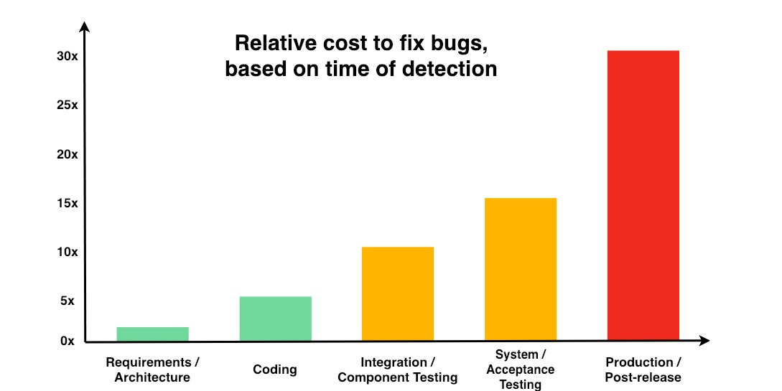
Importance of Testing
It’s important to allow sufficient time for testing
It’s vital that key staff are engaged in testing
Develop a well-thought-out plan for End-to-End Testing to help organize the team
Put time and money into testing now and you will save time and money in the long run
Source: National Institute of Standards and Technology (NIST),
Planning Report 02-3 The Economic Impacts of Inadequate Infrastructure for Software Testing

Slide 21
Governance & Communication Plan
The single biggest problem in communication is the illusion that it has taken place.
- George Bernard Shaw

Slide 22
Governance Structure & Escalation Path
Executive Sponsor
Daryl Stevenson General Manager Nimble AMS
Project Manager
Nick Ricci
Project Sponsor
Prassanth Lakshminarasimh
Project Manager
Nick Ricci
Project Manager
Phyllis Carroll
Escalation Path
Functional stakeholders + Subject Matter Experts
Consulting Lead/Director
Geoff Williams
Development Manager
Jake Juby
Data Conversion Lead
Jim Zerbe
Sales Account Executive
Rob Banwar
Consultant
Jeremy Thompson
Software
Developer(s)
Data Specialist
Customer Success
Julie Tracz

Slide 23
Communication & Governance
Communication:
Primary Point of Contact for Nimble AMS is the Project Manager
PM Communication Tools: Google Drive and Basecamp
Consultants and Project Team Communication Tools: Confluence and Jira
Document Requirements and Test Scripts
Log and Track Issues
Governance:
Regular status meetings
Documented Decisions, Issues and Risks
Tracking of Action items
Reporting burn rate on budget
NOTE: AFP requires hours spent be reported in one of two data categories:
Planning
Implementation
Monitoring Schedule

Slide 24
Communication Tools
Tool | Purpose | Use Frequency for AFP
 | Basecamp is an online private, secure space where teams can organize and discuss everything about a project. This essentially replaces email and allows for all communication and deliverables to be stored in one location. | High
 | Contains the project requirements in the form of epics, tasks, and stories. Manages the project deliverables. Feedback that is a direct result of testing should be logged here in the form of bug tickets. Client Licenses Limited to four per organization. | Medium
 | Contains the test suites & success guides used for testing and reference after go-live. Each AFP has their own space. Internally, Confluence is used for employee spaces and process management. | Medium
 | Google Drive provides a shared workspace for project artifacts, including contracts, requirements documentation, meeting notes, and slides. | Medium
Microsoft Project | Microsoft Project used to document project schedule and track completion of milestones. Client copies can be distributed in PDF format if/as necessary. | Medium

Slide 25
Another Look at Project Communication
Microsoft Project
Phyllis Carroll
Project Manager is the primary point of contact
Collaboration using Google Drive and Basecamp for Project Workbooks, Discovery Documents, Status Reports and Q&A.
Weekly status calls:
Decisions, Issues and Risks
Action items
Budget burn rate reporting
Project schedule
Jira and Confluence used to document requirements, user stories, and success guides. During testing period, used to log bugs.

Slide 26
Discovery Process
A good beginning makes a good ending!

Slide 27
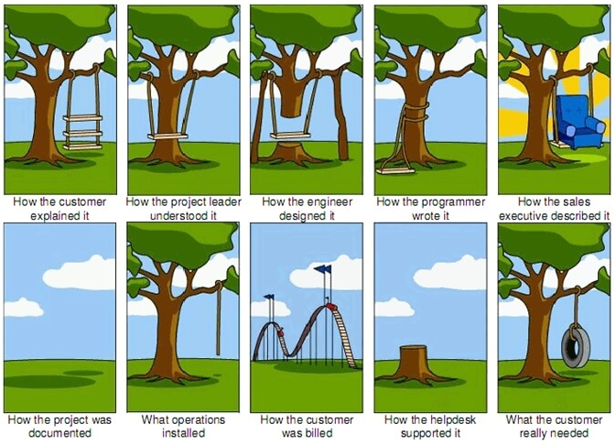
Importance of Requirements
A Good Requirement states:
Who is Responsible
What Shall be Done
Defines Scope, Needs, Goals, Objectives
Identifies Constraints and Dependencies
Documents Assumptions
Defines all external interfaces
States the Vision and allows for Buy-In from all Stakeholders
Tools
User Stories

Slide 28
What is a user story?
“As a <user profile>, I need to be able to do something so I can accomplish some goal/recognize some business benefit.”
Provides a non-technical explanation of how the system needs to be able to act from the user’s perspective
Define the expectation for the end result—”begin with the end in mind”
Explain the who, what, when, where, and why…just not the how

Slide 29
Writing Good User Stories
Who is using this functionality?
What is the functionality that is needed?
What is the business benefit of this feature? What does it enable the user to do that they couldn’t do otherwise?
Is this story adequate to cover all aspects of what the user needs in this feature?
Am I describing what the user needs vs how I think things should be done?
Did I include enough information to lead to a design that meets my user’s needs?

Slide 30
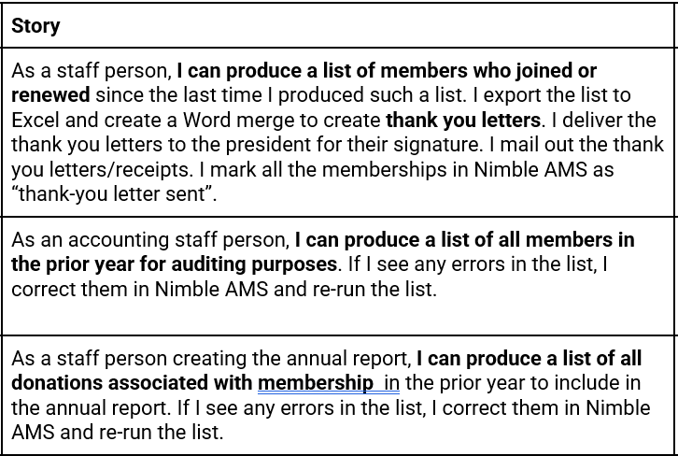
Sample User Stories

Slide 31
Discovery Process
Remote Meetings
Identify System Requirements
Review Business processes and rules
Pre-requisites: Completed Workbooks & Familiarization Training
Nimble AMS Team
AFP Team
Lead Discussion
Document requirements
Configure Base Nimble AMS
Determine Scope of Data Conversion
Provide Solutions and LOE
Document contractual changes if needed
Provide business process information and artifacts
Existing SOPs, Reports, Forms
Legacy Applications
Answer questions and review documentation
Select work to be funded
Sign-off on scope

Slide 32
How the Discovery Sessions Work
Nimble Team leads series of remote sessions
AFP team members attend sessions relevant to them.
In each session, we use the AFP’s workbooks as a reference to discuss questions and current business processes attached to them.
We invite you to...
be collaborative
be open to changing current processes
be OK with bumping things to phase 2

Slide 33
What to Expect During Discovery
We ask you to approach Discovery with openness and collaboration
We are working towards a common goal
We may challenge your existing practices
We will offer suggestions to streamline processes
We will provide options to avoid custom configuration
We will ask you to confirm our understanding

Slide 34
What to Expect During Discovery
Discovery Workshop
Gap Requirements
To manage scope and schedule, you may need to prioritize requirements.
Some scope may be moved to the roadmap for future phase.
Rough Order of Magnitude (ROM) provides a range of hours to help with prioritization
Low < 10 Hours
Medium 10-50 Hours
Large 50-100 hours
Internal Reviews & Feedback Sessions
Approved
Deferred / Declined
Prioritization
Rough Order of Magnitude (ROM)
Future Phase
Scope & Cost Baseline
High-Level Technical Solution
Future Phase
Implementation Phase

Slide 35
Meeting the Go-Live Goal
3 legs of the project management stool:
Scope
Timeline
Resources
Delaying the go-live date (timeline) will impact the resources ($$)
These common events will impact both resources ($$) and timeline:
Increasing scope
Staff turnover
Any sort of delays
Scope
Resources
Timeline

Slide 36
Next Steps

Slide 37
Next Steps
Complete Workbooks & Deliver to Geoff Williams
Due no later August 30th (sooner = better)
Schedule Discovery Q&A Sessions – Geoff Williams
Schedule Kickoff Data Discovery Session –Jim Zerbe
Schedule Weekly Status Meetings – Phyllis Carroll
Document Blackout Periods in Schedule – Phyllis Carroll (AFP input)
Allow Staff Time for Discovery – AFP Management

