Slide 1
BE the CAUSE Webinar 2025
Notes:
David:
Hello!
Welcome to the AFP Foundation for Philanthropy BE the CAUSE Webinar for 2025, welcoming our new foundation development chairs!

Slide 2
Foundation Development Chair Orientation
Presented by:
David Coyne, CFRE, AFP Foundation for Philanthropy Fundraising Board Chair
Ann Hale, CFRE Interim Executive Vice President, Foundation Staff
Ayat Hassan, MBA Foundation Operations Director, Foundation Staff
February 26, 2025
Notes:
David
Read introductions and names
Both Ann and Ayat are available at any time to assist you and your chapter.
But just so you know specific roles. Ayat is the staff person responsible for the BE the CAUSE Campaign so she should be your first point of contact and who you will hear from the most.
Ann has the overall responsibility for the Foundation including our board governance and major gifts initiatives. But am also always available to answer any questions that you may have.

Slide 3
Orientation Objectives
What is the AFP Foundation for Philanthropy?
Impact
Fundraising priorities
Campaigns
BE the CAUSE: Foundation’s annual fund and our fundraising priority!
What IS it?
What does it do?
How does it impact you?
Resources, responsibilities, and raising funds
Notes:
David
The objectives of this webinar is to:
Tell you about the Foundation for Philanthropy
1. What is the Foundation for Philanthropy and how is it different than AFP
2. We want to show you the true impact of what the Foundation does
3. We want to be clear about our fundraising priorities, as well as our methods, for full transparency while working with you
BE the CAUSE
BTC is the Foundation for Philanthropy’s annual fund
Supports so much of what we do – scholarships, grant backs, networking opportunities, professional development and more! We’ll go into detail later.
BE the CAUSE is one of the priorities of Foundation Development Chairs
Support
What exactly is the role of the Foundation Development Chair?
What the Foundation does all year to provide you with support, resources, content and more!

Slide 4
What IS the AFP Foundation for Philanthropy?
The AFP Foundation enhances philanthropy and volunteerism
through programs of education, research and service that benefit
all those who lead, serve and support nonprofit institutions.
Notes:
David
What IS the Foundation for Philanthropy?
We are an independent 501 c(3)
AFP is a membership organization that is classified as a 501 (c) 6
We operate in tandem but we are a purely nonprofit organization that relies on donations to make impact in our profession
4. We do not fund any AFP operations.
5. No membership dues are used by the Foundation

Slide 5
Case for Support – The Foundation for Philanthropy’s Priorities
Growing Fundraising Leadership For a Better World
What does the Foundation support?
Leadership Development
IDEA (Inclusion, Diversity, Equity and Access)
Ethics
Research
Notes:
Ann
Tell you a bit about the Foundation’s priorities and our case for support. A couple of years ago, the Foundation developed a new Case for Support. Through that process, we identified four priority areas that support the Foundation’s mission to enhance philanthropy and volunteerism for the benefit of all those who lead, serve and support nonprofit institutions.
The priorities are:
Leadership Development
IDEA
Ethics
4. Research
Leadership Development -- our Goal is to Attract and Develop Fundraising Leaders. We have several leadership development initiatives that you have probably heard about. AFP LEAD (formerly Leadership Academy) is a Foundation-funded event. Scholarships are available through Blackbaud and Levy. We also offer a Chamberlain Scholar for AFP ICON to every single chapter every single year so those individuals have an opportunity to attend the largest fundraising conference in the world and have educational, networking, and leadership development opportunities. We also have a new initiative, titled the Leadership Development Program that will directly address the growing issue of the Boomer generation retiring and the lack of qualified leaders in fundraising to take their places. It includes the Leadership Institute program and AFP Catalyst, a new program for senior leaders happening at ICON this year. This initiative isn’t funded through our annual fund, BTC, but through major gift efforts.
Our work with Inclusion, Diversity, Equity and Access is really focused on building a Stronger Sector Through a More Diverse Workforce. Both AFP and the Foundation for Philanthropy have many initiatives that fall under the IDEA umbrella, and we’ll talk more about those later. Diversity Scholarships, WII mentoring.
Ethics pillar is focused on helping to renew Public Trust in Charitable Organizations. Hopefully, you have heard of AFP Ethics Awareness Month that the Foundation helps to fund, largely through endowment funds.
4. Our final pillar is Supporting Research on Critical Issues in Fundraising. We are funding critical research that supports the fundraising profession, such as the FEP, which provides vital data that helps all of us in the fundraising profession. The Research Council moved under the Foundation umbrella in 2022, and we fund much of this research through endowed funds and gifts including the Skystone Ryan Prize given to an author of a book that advances understanding of fundraising and philanthropy, Bill Levis Research Grants for new academic research, and FEP.

Slide 6
AFP Foundation for Philanthropy
Leadership Development
Research
IDEA
Ethics
Scholarship
AFP Leadership Institute Program
LEAD
Diversity Scholarships
Mentoring Program
Fundraising Effectiveness Project
Research Grant
Research Prize
Ethics Month
Endowed Ethics Funds
Notes:
Ann
Here a chart of our 4 pillars. As you can see scholarships are an important aspect of our work. In 2024 we provide a total of 218 scholarships to AFP members. That includes:
105 Chamberlain Scholars (first-time conference attendees to the AFP ICON)
90 Diverse Communities and Blackbaud Diversity Scholars to the AFP ICON and LEAD
14 Collegiate Scholars funded by Marjorie K. & Stephen M. Levy
9 Scholarships for AFP ICON through the AFP/Alford Group Women’s Mentoring Program

Slide 7
Our Fundraising Priorities
BE the CAUSE: our annual fund
Chapter IMPACT: our annual fund campaign to engage chapters
Major Gifts: one example is our Leadership Development program that is being created
Endowments: to fund scholarships and programs in perpetuity
Notes:
Ann: To support the mission, we have several fundraising priorities and strategies.
BTC is our annual fund, and we truly rely on help from our FDC’s to achieve our goals.
We also have the Chapter Impact program where the Foundation asks AFP Chapters to consider a gift from their budget to support the fundraising profession. Chapters can designate for a specific area of support or provide unrestricted funds for the Foundation to determine where the funds should be best directed. The areas of focus that the chapters can choose are Leadership development, IDEA, Chamberlain Scholarships, or Unrestricted. There is a $50 minimum gift to meet the 10-star requirements, and the chapter can make their gift via mail, email, over the phone, or online. The online link is on the BTC toolkit.
We also have a major gift program that we are working to grow. Major Gifts from individual, chapters, corporations, and foundations help to fund things such as the Leadership Development Program that was mentioned earlier.
I do want to take a quick moment to thank the chapters that have made major gifts – they are CA, Orange County, NJ, NYC, OH, Central, and OH, Greater Cincinnati
- And the foundation has many donors who make gifts that are endowed in perpetuity to help fund scholarships, Ethics Month, and other areas like ICON, LEAD, Ethics – whatever the donor is most passionate about.

Slide 8
What is BTC and what does it impact?
Scholarships: 218 were given out in 2024 alone! We support young professionals, diverse fundraisers and many more
Foundation Grant Back Program: a portion of the funds raised goes DIRECTLY back to your chapter – so you can make an impact in your community while also supporting the entire profession
Notes:
Ann – So what is the BTC and what does it impact?
As mentioned previously, BTC is Our annual fund
Supports scholarships – 218 in 2024! Scholarships support young professionals, diverse fundraisers, first time ICON attendees, and many more.
It also supports the chapter Grant Back program: a portion of the funds raised goes DIRECTLY back to your chapter – so you can make an impact in your community while also supporting the entire profession
We’ll go into greater detail about these later
And there is the Foundation Grant Back Program: a portion of the funds raised goes DIRECTLY back to your chapter – so you can make an impact in your community while also supporting the entire profession
So why is it important to support this campaign? Because BTC positively impacts AFP members, your local communities, the entire profession and YOU through programs that help fundraisers to be better able to serve the nonprofits they work for and also their local communities.

Slide 9
2024 BE the CAUSE Campaign Highlights $305,651 raised in 2024 Thank you all for a successful year!
Notes:
Ann
First I want to thank all of the chapters that participated in 2024. It was a successful year thanks to your efforts to encourage support from Chapter members.
Last year, BTC raised $1,738,989 overall for the Foundation which includes in kind support of $201,500 and a $900,000 grant that we received from Fidelity Charitable Catalyst Fund.
BTC total giving was 87.3% of our goal
This was down from 2023, which follows the FEP trends we’re seeing nationwide. We/Ayat are going to talk about this later in the presentation.

Slide 10
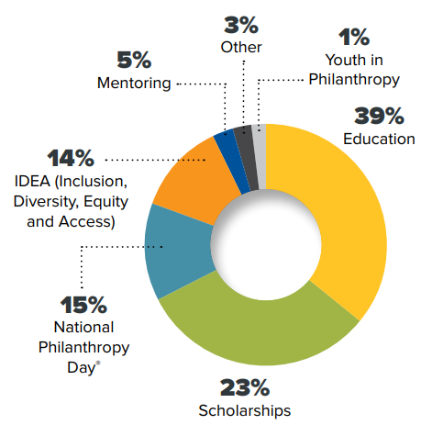
2024 Foundation Grant Back Usage
Notes:
Ann
It’s important to us to reward all of your hard work, so as I mentioned previously we ensure that a portion of BTC funds raised go directly back to your chapters to provide local impact through our incentive grant back program. You can see here how chapters utilized the funds granted back last year.
Further along in our orientation we will explain how your chapter can receive your grant back in 2025 for your 2024 efforts.

Slide 11
Where will your gifts go in 2025?
AFP Foundation for Philanthropy
Leadership Development
Research
IDEA
Ethics
Scholarship
AFP Leadership Institute Program
LEAD
Diversity Scholarships
Mentoring Program
Fundraising Effectiveness Project
Research Grant
Research Prize
Ethics Month
Endowed Ethics Funds
Notes:
Ann
I know that it is very important that you have a case for support as you ask your chapter members to consider giving to the AFP Foundation. I already mentioned some of these items, but wanted to provide a little more detail about what BTC dollars support.
BE THE CAUSE DONOR DOLLARS GO TO THE FOLLOWING
Leadership Development: Chamberlain Scholarships to ICON are a key component in leadership development. Also, AFP LEAD is an AFP Foundation event that the BTC dollars directly fund. AFP LEAD provides the opportunity for fundraisers to learn the skills required to grow into senior leadership positions within the nonprofit sector. Scholarships are also awarded for those looking to lead their local chapters and develop new professional skills.
IDEA-The AFP IDEA Inclusion, Diversity, Equity and Access Impact program is a phased, multi-year approach focused on empowering and educating diverse communities. Each initiative has four components: research, education, support and guidance, and awareness. The goal is to prepare the next generation of diverse fundraisers to lead the profession.
The Diverse Communities Scholarship Program was created by AFP and receives funding from the Foundation for Philanthropy to provide financial assistance for fundraisers who are themselves members of a diverse community or are employed by grassroots organizations that primarily serve diverse populations to attend the AFP International Conference on Fundraising.
The Women’s Impact Initiative is the first initiative to assess, address and highlight the specific issues and challenges that women in the fundraising profession face, including pay equity, harassment, inclusion in leadership, and male allyship. The objectives are research, education, leadership development, implementation, and mentorship.
The Alford Group IDEA Mentoring and Leadership Development Program was launched in 2019 and includes leadership development education, in person meeting opportunities at AFP LEAD, leadership topics and development webinars, cohort facilitated webinars, and executive coaching. The Foundation supports all of these IDEA efforts.
Research –The Fundraising Effectiveness Project (FEP) was created to help nonprofits increase giving at a faster pace. The FEP pursues this goal by providing nonprofits with tools for tracking and evaluating their annual growth in giving and identifying areas where organizations should focus their fundraising efforts. The FEP also releases quarterly reports on levels of giving and numbers of donors in both the U.S. and Canada. We also offer several grants to support research that helps fundraisers in their work.
Ethics-AFP created the Code of Ethical Standards in 1960 to foster the development and growth of fundraising professionals and the profession, to promote the highest ethical behavior in the fundraising profession and to preserve philanthropy and volunteerism.
Ethics Awareness Month is the key program support by the Foundation: The Ethics Awareness Month, held annually in October, is dedicated to helping fundraising professionals understand the Code of Ethics, grow ethical skills, and demonstrate their commitment to the highest ethical standards.

Slide 12
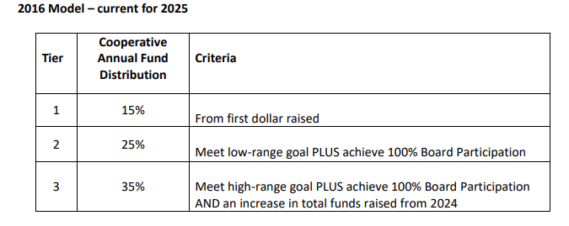
BE the CAUSE Grant Back Program
Notes:
Ayat:
All chapter leaders should have received an email from me in early February with your chapters new 2025 proposed low and high goals, a copy of your chapters 2024 chapter tally report, and a 2024 Grant Back form.
The Grant Back program is a grant that is given back to the chapters based on their low and high goal as well as 100% Board participation of the prior year. Every participating chapter receives either 15, 25, or 35% back of the BE the CAUSE dollars raised in the previous year.
This grant is to be used to fund chapter activities like Education, scholarship, National Philanthropy Day activities, Youth in Philanthropy programs, Diversity programs, Mentoring programs, or any activities that will advance ethical and effective fundraising
And here you can see all the criteria that must be met in order to receive each percentage back

Slide 13
Foundation Development Chair (FDC)
Also known as the BE the CAUSE Campaign Chair
Main Responsibilities: Educate, cultivate, solicit, and steward
Key Tasks: Recruiting, recognizing donors, communication, educating chapter leaders, and coordinating the campaign's efforts.
Make a personally meaningful gift to the BE the CAUSE campaign
Notes:
Ayat- The Foundation Development Chair (FDC) acts as a liaison between the chapter and the AFP Foundation for Philanthropy. This position is also known as the BE the CAUSE Chair
The FDC's main responsibilities are to educate, cultivate, solicit, and steward individual donors for the foundations annual campaign, specifically the BE the CAUSE Campaign.
Key tasks include recruiting committee members, recognizing donors, communicating the campaign’s value, educating chapter leaders, and coordinating the campaign's efforts.
The FDC also motivates members to support the campaign, monitors progress, resolves donor discrepancies, and reports regularly to chapter leaders.
Additionally, the FDC is encouraged to make a personal donation, share chapter stories that reflect its mission, and maintain active engagement with AFP Foundation staff. The role also involves sharing fundraising strategies, contributing messaging for the campaign, and ensuring a smooth transition by passing on records to the successor.
If you would like to read through The FDC description, it can be found on the BTC toolkit.

Slide 14
2025 BE the CAUSE Resources and Tool Kit
https://afpglobal.org/USFoundation/be-cause-campaign-toolkit#toolkit
Notes:
Ayat:
Everything you need to have a successful 2025 BTC campaign year can be found on the BTC tool kit. (Click)
Here you will find information on the foundation like our impact statement, the Foundation Development Chair Job Description, our code of ethics, donor bill of rights, and FAQ.
You will also find all gift/pledge forms like the chapter IMPACT form, the BTC form, and the 100% Board participation form.
Under the BE the CAUSE Campaign Materials title you will see the Foundations important dates and deadlines, our giving levels, as well as the Donor Pin Order form which the Foundation provides for free to the chapters.
And all the way at the bottom your chapter can now make a 2025 unrestricted chapter IMPACT gift. There is no need to log in! Click link
The Toolkit has a wealth of information for everything you need to know so I highly recommend bookmarking this site.

Slide 15
Database & Reports
No Login Gift Giving
Text AFP to 571-749-2699
New way to access the Chapter Tally reports
Notes:
Ayat
We have multiple ways anyone can make a gift online without having to log in!
Give by Cell has extended their in-kind gift so we will continue to have the text option. We were able to work with give by cell to add a chapter designation field to assure that every gift will be credited
Chapter leaders should now have access to the tally report If you are having any issues viewing the tally report please contact me directly.
If a new gift comes in it will take about 3 hours to refresh the report
Ann and I are here to help any way possible. We want to see your chapter succeed!

Slide 16
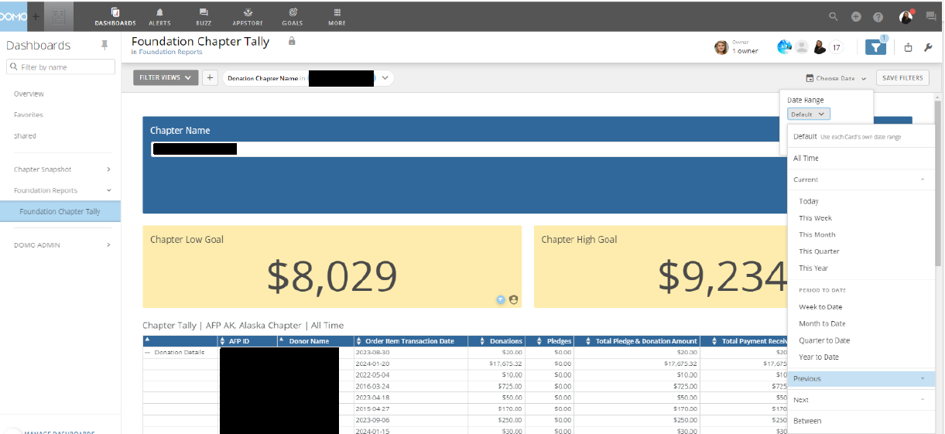
Notes:
Here is just a recap on how to pull your chapter reports.
Filer by Date

Slide 17
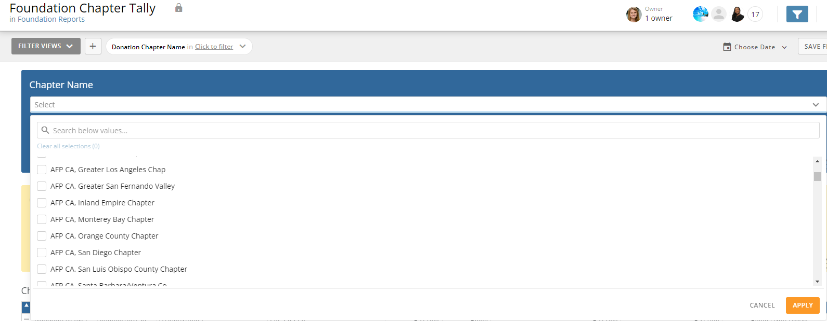
Notes:
If you are and admin or FDC for multiple chapters you can select each chapter

Slide 18
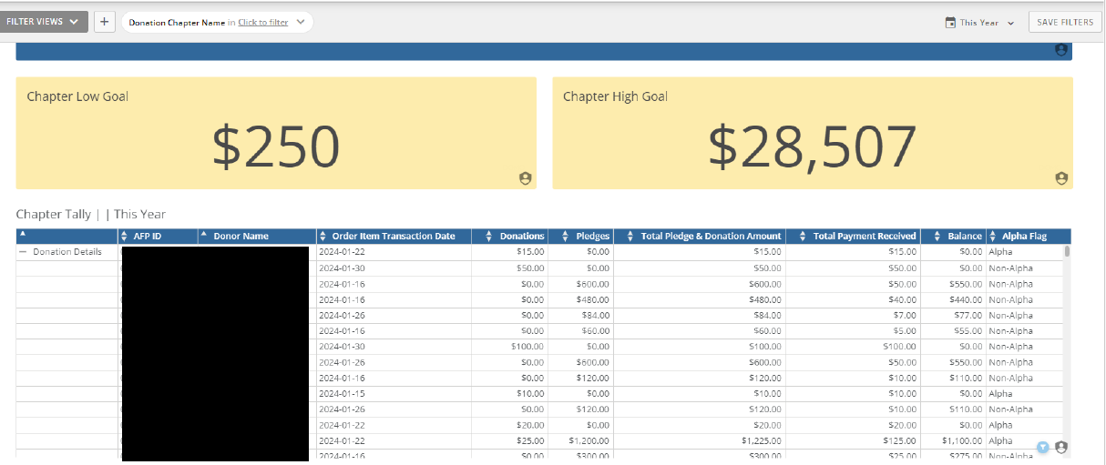
Notes:
Low and high goal (explain the low and high goals and how we come up with the goals and that we are happy to work with the chapter please contact me)
Donor ID
Name
Transaction date of last pledge or gift
Amounts
Alpha

Slide 19
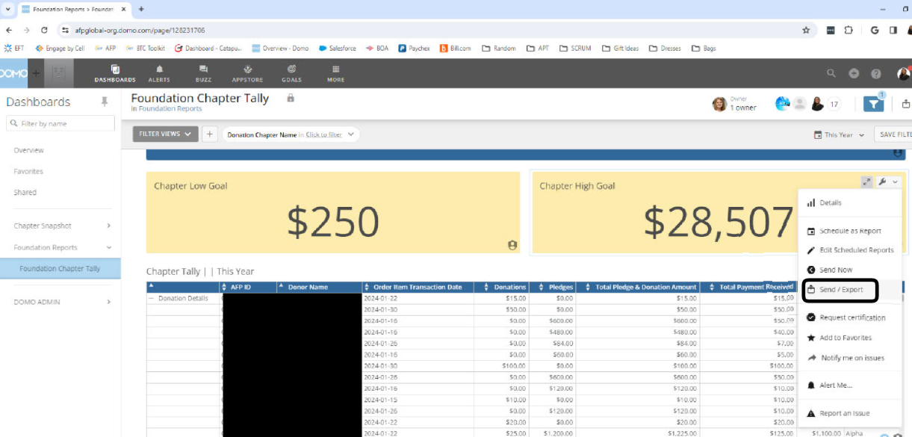
Notes:
Export files
Instructions are on the BTC toolkit and if you are having issues, please don’t hesitate to reach out to me.

Slide 20
How does the Foundation support your work?
Donor Acknowledgment Policy
Stewardship
Gift processing/thank you letters
Pledge reminders
Renewal letters
Donor Pins
Catapult Calling Program
Text to Give
Text AFP to 571-749-2699
Notes:
Ayat:
Just a few things that the foundation does to support you and your chapter:
We handle gift processing and acknowledgement
We send pledge reminders
We send renewal letters
As stated in the previous screen we also Provide donor pins and much more
The Catapult calling programs is an in kind gift from Catapult Fundraising. They called 4,000 lapsed donors from 2023-2024, this started November 2024 and is on going. All gifts made in 2024 were credited to the 2024 BTC Campaign, and those gifts made in 2025 are being credited to the 2025 BTC Campaign.
Give by Cell will continue partnering with us by providing a mobile giving platform to the Foundation for mobile giving all year long. TEXT AFP to 571-749-2699

Slide 21
What Can You Do for Your Donors/Prospects?
Solicit chapter board members to reach 100% Board Participation (10 Star!)
Virtual donor reception
Recognize BTC donors at chapter educational events / National Philanthropy Day, etc.
Send thank you emails to donors each month
Engage board members to personally solicit members to make/upgrade gift
Profile your Chamberlain scholars in communications and appeals
Create a communications calendar about BTC
Notes:
Ayat
What Can You Do for Your Donors? Here are some suggestions that have been discussed by the AFP Foundation for Philanthropy Fundraising Board.
Solicit chapter board members to reach 100% Board Participation. This is a ten star requirement!
Host a Virtual donor reception
Recognize BTC donors at chapter educational events / National Philanthropy Day
Send thank you emails to donors each month
Engage board members to personally solicit members to make/upgrade gift
Profile your Chamberlain scholars in communications and appeals
Identify Chamberlain scholars in your chapter: what was their experience? How has it impacted their careers? Are they a donor?
Create a communications calendar for BTC. We have an example of one on the BTC Toolkit. This will help your chapter have consistent communications (I suggest highlighting the ICON & LEAD matching campaigns!)

Slide 22
A special thank you to…
For partnering with the AFP Foundation for the “Good Takeover Seattle, WA:
April 27-29: Dates of the Good Takeover Challenge Match
Notes:
David
The Foundation has continued partnerships with four prestigious organizations that will help you run your BE the CAUSE Campaign at the chapter level.
A special thank you to Blackbaud for partnering with the AFP Foundation. This year, we are thrilled to announce they are continuing their support and the Good Takeover Challenge will provide a $10 match to the first 1,000 donors who give a gift of at least $20 during the three days of ICON.
Just like last year, we will send out an all-member email about the match, on the first and third day of ICON. April 27-29, 2025.
It would be great to send out an announcement about this match from your chapter to your members to compliment the email that the Foundation will send.

Slide 23
Thank you!
For partnering with the AFP Foundation for Philanthropy for the match over the dates of AFP LEAD
Notes:
David
We have also secured a match for AFP LEAD brought to you by Hazen/HILT.

Slide 24
In Kind Support Provided by
Notes:
David
As Ayat mentioned, Catapult provides in kind support by calling 4,000 lapsed donors annually.
Give by Cell provides in kind support by offering the mobile giving platform to the Foundation for Philanthropy.

Slide 25
Chapter Engagement
AFP Foundation Board members available to talk to your chapter
Notes:
David
Opportunity to have a FND Board member to come and speak to your chapter board or members
Last year the Foundation reach out to 90 chapters in 2024 and have plans to reach out to 102 in 2025. If you would like to be proactive about a presentation, please reach out to Ann and Ayat and then can get you connected to a board member.
Invite a board meeting to talk about the Foundation about our impact
The good news is there are board members that are excited and eager to come in and speak

Slide 26
Open Discussion
Notes:
David
Facilitate any questions.
Pause and see if anyone has a question or comment.
Sample questions to ask
Knowing that there is a match over the dates of AFP ICON, do you have any suggestions for what has worked well in the past to promote it from the chapter level.
Knowing that last year was tough, especially with the database conversion, anyone have any suggestions for overcoming challenges?
When done, thank everyone for taking on this leadership role for AFP.

Slide 27
AFP Foundation Staff
We’re here to support you!
Ann Hale, MA, CFRE Interim Executive Vice President
(434)236-5586
Ann.hale@afpglobal.org
Ayat Hassan, MBA Foundation Operations Director
(703) 519-8448
Ayat.hassan@afpglobal.org
Notes:
David
And we have two staff in the foundation that you will work with throughout the year.
Ann
Ayat

