Slide 1
BE the CAUSE Webinar 2024
Notes:
Paul:
Hello!
Welcome to the AFP Foundation for Philanthropy BE the CAUSE Webinar for 2024, welcoming our new foundation development chairs!

Slide 2
Foundation Development Chair Orientation
Presented by:
Paul Dunne, CFRE, AFP Foundation for Philanthropy Fundraising Board Chair
Lori Gusdorf, CAE, Executive Vice President, Foundation Staff
Ayat Hassan, MBA Fundraising & Database Analyst Associate, Foundation Staff
February 26, 2024
Notes:
Paul
Read introductions and names
Both Ayat and Lori are available at any time to assist you and your chapter.
But just so you know specific roles. Ayat is the staff person responsible for the BE the CAUSE Campaign so she should be your first point of contact and who you will hear from the most.
Lori has the overall responsibility for the Foundation including our board governance and major gifts initiatives. But am also always available to answer any questions that you may have.

Slide 3
Orientation Objectives
What is the AFP Foundation for Philanthropy?
Impact
Fundraising priorities
Campaigns
BE the CAUSE: Foundation’s annual fund and our fundraising priority!
What IS it?
What does it do?
How does it impact you?
Resources, responsibilities, and raising funds
Notes:
Paul
The objectives of this webinar is to:
Tell you about the Foundation for Philanthropy
1. What is the Foundation for Philanthropy and how is it different than AFP
2. We want to show you the true impact of what the Foundation does
3. We want to be clear about our fundraising priorities, as well as our methods, for full transparency while working with you
BE the CAUSE
BTC is the Foundation for Philanthropy’s annual fund
Supports so much of what we do – scholarships, grant backs, networking opportunities, professional development and more! We’ll go into detail later.
BE the CAUSE is one of the priorities of Foundation Development Chairs
Support
What exactly is the role of the Foundation Development Chair?
What the Foundation does all year to provide you with support, resources, content and more!

Slide 4
What IS the AFP Foundation for Philanthropy?
The AFP Foundation enhances philanthropy and volunteerism
through programs of education, research and service that benefit
all those who lead, serve and support nonprofit institutions.
Notes:
Paul
What IS the Foundation for Philanthropy?
We are an independent 501 c(3)
AFP is a membership organization that is classified as a 501 (c) 6
We operate in tandem but we are a purely nonprofit organization that relies on donations to make impact in our profession
4. We do not fund any AFP operations.
5. No membership dues are used by the Foundation

Slide 5
Case for Support – The Foundation for Philanthropy’s Priorities
Growing Fundraising Leadership For a Better World
What does the Foundation support?
Leadership Development
IDEA (Inclusion, Diversity, Equity and Access)
Ethics
Research
Notes:
Lori
The Foundation developed a new Case for Support. Through the process four priority areas were identified for the Foundation.
Leadership Development
IDEA
Ethics
4. Research
Attract and Develop Fundraising Leaders = Leadership Development. We have several leadership development initiatives that have been going for years. AFP LEAD (formerly Leadership Academy) is a Foundation-funded event. Scholarships are available through Blackbaud and Levy. We also offer a Chamberlain Scholar to every single chapter every single year so those individuals have an opportunity to attend the largest fundraising conference in the world and have educational, networking, and leadership development opportunities. We also have a new initiative, titled the Leadership Development Program that will directly address the growing issue of the Boomer generation retiring and the lack of qualified leaders in fundraising to take their places. This initiative won’t be funded through our annual fund, BTC, but through major gift efforts.
Build a Stronger Sector Through a More Diverse Workforce = Inclusion, Diversity, Equity and Access. Both AFP and the Foundation for Philanthropy have many initiatives that fall under the IDEA umbrella, and we’ll talk more about those later. Diversity Scholarships, WII mentoring.
Renew Public Trust in Charitable Organizations = Ethics. Hopefully, you have heard of AFP Ethics Awareness Month that the Foundation helps to fund, largely through endowment funds. Skystone, Levis Grants and FEP. Research Council moved to the Foundation in 2022.
4. Support Research on Critical Issues in Fundraising = Research that supports the fundraising profession, such as FEP, which is vital data that helps all of us in the fundraising profession.

Slide 6
AFP Foundation for Philanthropy
Leadership Development
Research
IDEA
Ethics
Scholarship
AFP Leadership Institute Program
LEAD
Diversity Scholarships
Mentoring Program
Fundraising Effectiveness Project
Research Grant
Research Prize
Ethics Month
Endowed Ethics Funds

Slide 7
Our Fundraising Priorities
BE the CAUSE: our annual fund
Major Gifts: one example is our Leadership Development program that is being created
Endowments: to fund scholarships and programs in perpetuity
Notes:
Lori:
The Foundation has three primary methods of raising funds.
- BTC is our annual fund and we truly rely on help from our FDC’s to achieve our goals.
- Major Gift initiatives help to fund things such as the Leadership Development Program that was mentioned earlier. Another note about the LDP: the creation of the program was in direct response to member needs, chapters involved, summit, launching program
- Endowments help fund scholarships, Ethics Month, and other areas like ICON, LEAD, Ethics

Slide 8
What is BTC and what does it impact?
Scholarships: 247 were given out in 2023 alone! We support young professionals, diverse fundraisers and many more
Foundation Grant Back Program: a portion of the funds raised goes DIRECTLY back to your chapter – so you can make an impact in your community while also supporting the entire profession
Notes:
Lori
BTC – why is it important to support this campaign? BTC supports both your local communities, while also supporting the entire profession.
It’s important to us to reward all of your hard work, so we ensure that a portion of BTC funds raised go directly back to your chapters to provide local impact. But, you’re also part of a global profession, and BTC elevates that profession through scholarships and other programming.
Our annual fund
Supports scholarships – 247 in 2023! (read slide)
Supports Grant Back program (read slide)
We’ll go into greater detail about these later

Slide 9
2023 the CAUSE Campaign Highlights $301,432 raised in 2023 Thank you all for a successful year!
Notes:
Lori
$896,717 overall for the Foundation in 2023 (88% of goal) which includes in kind support of $226,500.
This was down 31% from 2022, follows the FEP trends and database. We/Ayat are going to talk about this later in the presentation.

Slide 10
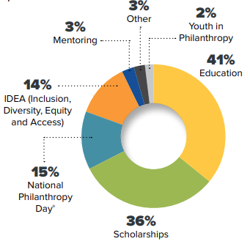
Your 2022 Gifts Helped Support
$78,484 in support back to 109 local chapters for:
Education: 41%
Scholarships: 36%
NPD: 15%
YIP: 2%
IDEA: 14%
Mentorship: 3%
Other: 3%
$67,222 in awards for scholarships
102 Chamberlain Scholars (first-time conference attendees to the AFP ICON)
121 Diverse Communities and Blackbaud Diversity Scholars to the AFP ICON and LEAD
5 Collegiate Scholars funded by Marjorie K. & Stephen M. Levy
19 Scholarships for AFP ICON through the AFP/Alford Group Women’s Mentoring Program
Notes:
Lori
You can see here some of the funding that the Foundation provided last year. A large portion of funds went back to chapters to provide services in local communities and the other majority was for scholarships.
Further along in our orientation we will explain how your chapter can receive your grant back in 2024 for your 2023 efforts.

Slide 11
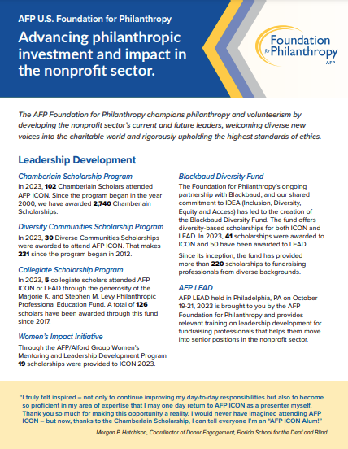
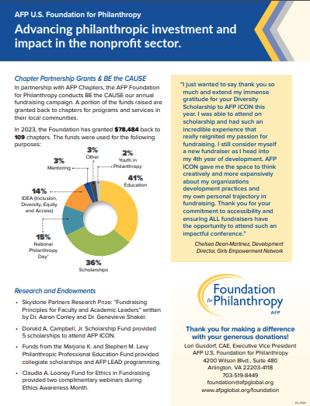
Foundation’s Impact Statement
Notes:
Lori
Foundation for Philanthropy’s Impact Statement:
We keep this constantly updated and on our website for you to use whenever you need information, graphics, or content to send out! Please feel free to download and utilize.

Slide 12
Where will your gifts go in 2024?
Supporting key programs and initiatives:
Scholarships
- Chamberlain
Diversity
Collegiate
AFP LEAD
Women’s Impact Initiative ongoing efforts
Emerging Leaders Program
Growth in Giving Initiative
Local chapter initiatives
Notes:
Lori
I know that it is very important that you have a case for support as you ask your chapter members to consider giving to the AFP Foundation. I already mentioned these items, but I think it is worth repeating.
BE THE CAUSE DONOR DOLLARS GO TO THE FOLLOWING
Scholarships to the AFP International Conference (Chamberlain and Diversity)
AFP LEAD
Research – which includes the Growth in Giving Initiative and Fundraising Effectiveness Project (FEP)
Women’s Impact Initiative and ongoing efforts
Emerging Leaders Program
Local chapter initiatives

Slide 13
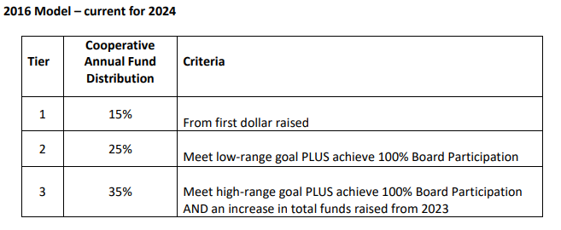
BE the CAUSE Grant Back Program
Notes:
Ayat:
All chapter leaders should have received an email from me in early February with your chapters new 2024 proposed low and high goals, a copy of your chapters 2023 chapter tally report, and a 2023 Grant Back form.
The Grant Back program is a grant that is given back to the chapters based on their low and high goal as well as 100% Board participation of the prior year. Every participating chapter receives either 15, 25, or 35% back of the BE the CAUSE dollars raised in the previous year.
This grant is to be used to fund chapter activities like Education, scholarship, National Philanthropy Day activities, Youth in Philanthropy programs, Diversity programs, Mentoring programs, or any activities that will advance ethical and effective fundraising

Slide 14
2024 BE the CAUSE Resources and Tool Kit
https://afpglobal.org/USFoundation/be-cause-campaign-toolkit#toolkit
Notes:
Ayat:
Everything you need to have a successful 2024 BTC campaign year can be found on the BTC tool kit. (Click)
Here you will find information on the foundation like our impact statement, our code of ethics, donor bill of rights, and FAQ.
You will also find all gift/pledge forms like the chapter IMPACT form, the BTC form, and the 100% Board participation form.
Under the BE the CAUSE Campaign Materials title you will see the Foundations important dates and deadlines, our giving levels, as well as the Donor Pin Order form which the Foundation provides for free to the chapters.
The Toolkit has a wealth of information for everything you need to know so I highly recommend bookmarking this site.

Slide 15
Database & Reports
New Online Donation Platform
Text AFP to 571-749-2699
Added Chapter Designation Field
New way to access the Chapter Tally reports
Notes:
Ayat
We are in process of implementing a more efficient and easier way for anyone to make a gift online that will not require a log in!
Give by Cell has extended their in-kind gift so we will continue to have the text option. We were able to work with give by cell to add a chapter designation field to assure that every gift will be credited to the correct chapter
We are also working on providing our chapter leaders to have access their reports.
The reports will not be limited to one person, you can have multiple Chapter Leaders to have access
It will be available 24/7. If a new gift comes in it will take about an hour to refresh the report and we are hoping to have everything available before ICON
Although we are confident that everything will work and be ready before ICON, but in the case of any issues, please reach out to me by phone or email. I would be happy to assist in running reports or process gifts.
Lori and I are here to help any way possible. We want to see your chapter succeed!

Slide 16
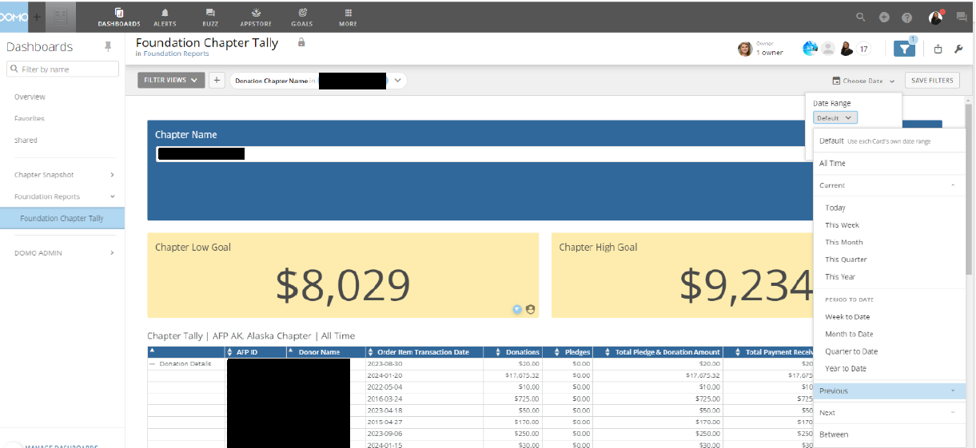
Notes:
Filer by Date

Slide 17
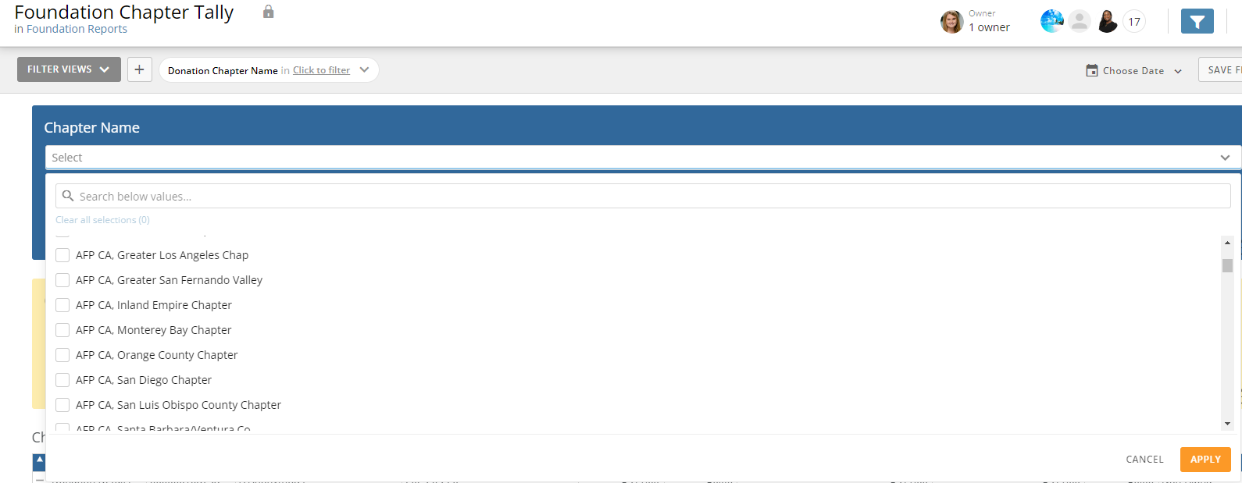
Notes:
If you are and admin or FDC for multiple chapters you can select each chapter

Slide 18
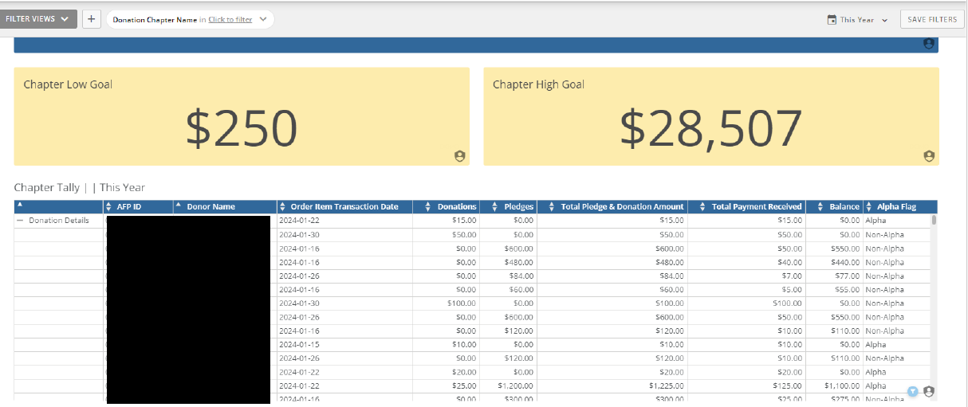
Notes:
Low and high goal
Donor ID
Name
Transaction date of last pledge or gift
Amounts
Alpha

Slide 19
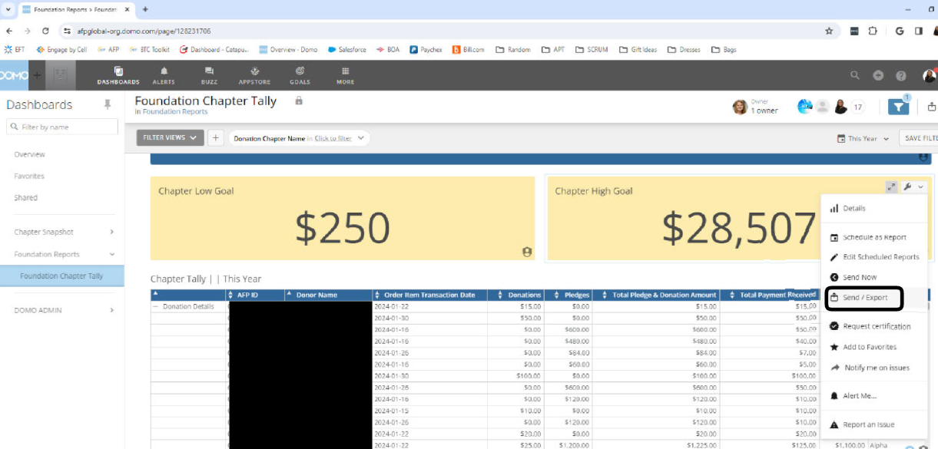
Notes:
Export files
As I mentioned, these reports will be ready before ICON, but in the meantime, please feel free to reach out to foundation@afpglobal.org at any time to get an updated report.

Slide 20
How does the Foundation support your work?
Donor Acknowledgment Policy
Stewardship
Gift processing/thank you letters
Pledge reminders
Renewal letters
Donor Pins
Catapult Calling Program
Text to Give
Text AFP to 571-749-2699
Notes:
Ayat:
Just a few things that the foundation does to support you and your chapter:
We handle gift processing and acknowledgement
We send pledge reminders
We send renewal letters
As stated in the previous screen we also Provide donor pins and much more
The Catapult calling programs is an in kind gift from Catapult Fundraising. They called 4,000 lapsed donors from 2022-2023, this started November 2023 and is on going. All gifts made in 2023 were credited to the 2023 BTC Campaign, and those gifts made in 2024 are being credited to the 2024 BTC Campaign.
Give by Cell will continue partnering with us by providing a mobile giving platform to the Foundation for mobile giving all year long. TEXT AFP to 571-749-2699

Slide 21
What Can You Do for Your Donors/Prospects?
Virtual donor reception
Thank you emails to donors each month
Engage board members to personally solicit members to make/upgrade gift
Identify Chamberlain scholars in your chapter: what was their experience? How has it impacted their careers? Are they a donor?
Create a communications calendar about BTC so you have consistent communications (highlight ICON/LEAD matching campaigns!)
Solicit your chapter board for 100% Board Participation (10 Star!)
Ask us to Zoom in to a board meeting to talk about the Foundation and our impact
Notes:
Ayat
What Can You Do for Your Donors? Here are some suggestions that have been discussed by the AFP Foundation for Philanthropy Fundraising Board.
Read the slide

Slide 22
A special thank you to…
For partnering with the AFP Foundation for the “Good Takeover Toronto, Canada:
April 7-9: Dates of the Good Takeover Challenge Match
Notes:
Paul
The Foundation has continued partnerships with four prestigious organizations that will help you run your BE the CAUSE Campaign at the chapter level.
A special thank you to Blackbaud for partnering with the AFP Foundation. This year, we are thrilled to announce they are continuing their support and the Good Takeover Challenge will provide a $10 match to the first 1,000 donors who give a gift of at least $20 during the three days of ICON.
Just like last year, we will send out an all-member email about the match, on the first and third day of ICON. April 7-9, 2024.
It would be great to send out an announcement about this match from your chapter to your members to compliment the email that the Foundation will send.

Slide 23
Thank you!
For partnering with the AFP Foundation for Philanthropy for the match over the dates of AFP LEAD
Notes:
Paul
We have also secured a match for AFP LEAD brought to you by Hazen/HILT.

Slide 24
In Kind Support Provided by
Notes:
Paul
As Ayat mentioned, Catapult provides in kind support by calling 4,000 lapsed donors annually.
Give by Cell provides in kind support by offering the mobile giving platform to the Foundation for Philanthropy.

Slide 25
Chapter Engagement
AFP Foundation Board members available to talk to your chapter
Board
Members
Notes:
Paul
Opportunity to have a FND Board member to come and speak to your chapter board or members
Last year the Foundation reach out to xx chapters in 2023 and have plans to reach out to 102 in 2024. If you would like to be proactive about a presentation, please reach out to Lori and Ayat and then can get you connected to a board member.

Slide 26
Open Discussion
Notes:
Paul
Facilitate any questions.
Pause and see if anyone has a question or comment.
Sample questions to ask
Knowing that there is a match over the dates of AFP ICON, do you have any suggestions for what has worked well in the past to promote it from the chapter level.
Knowing that last year was tough, especially with the database conversion, anyone have any suggestions for overcoming challenges?
When done, thank everyone for taking on this leadership role for AFP.

Slide 27
AFP Foundation Staff
We’re here to support you!
Lori Gusdorf, CAE, Executive Vice President
(800) 666-3863, ext. 449 or (703) 519-8449
Lori.gusdorf@afpglobal.org
Ayat Hassan, MBA Foundation Development Specialist
(800) 666-3863, ext. 448 or (703) 519-8448
Ayat.hassan@afpglobal.org
Notes:
Paul
And we have two staff in the foundation that you will work with throughout the year.
Lori
Ayat

