Slide 1
WELCOME!

Slide 2
Thank You to Our Sponsors!

Slide 3
Schedule at a Glance – Monday, June 28
10:00 – 11:05 AM Welcome with Alice Ferris, Featuring AFP President and CEO Mike Geiger/Opening Keynote: Heather McGhee
11:05 – 11:15 AM Break
11:15 AM – 12:30 PM Concurrent Education Sessions
12:30 – 12:50 PM Break
12:50 – 1:15 PM Mid-Day with Alice Ferris, Featuring AFP Foundation Chair Harry Lynch
1:15 – 1:20 PM Break
1:20 – 2:35 PM Concurrent Education Sessions
2:35 – 3:25 PM Virtual Marketplace
3:25 – 3:40 PM Afternoon Break with Alice Ferris
3:40 – 3:45 PM Break
3:45 – 5:00 PM Concurrent Education Sessions
5:00 – 5:05 PM Break
5:05 – 5:20 PM Opening Day Wrap Up/Passing of the Torch to Vince Duckworth
5:20 – 6:00 PM Networking

Slide 4
Schedule at a Glance – Tuesday, June 29
8:00 – 8:30 AM Morning Yoga
10:00 – 10:20 AM Welcome with Vince Duckworth, Featuring AFP Canada Chair Ken Mayhew and AFP Canada Foundation Chair Jane Potentier
10:20 – 10:25 AM Break
10:25 – 11:40 AM Concurrent Education Sessions
11:40 – 11:45 AM Break
11:45 AM – 1:00 PM Concurrent Education Sessions
1:00 – 1:30 PM Break
1:30 – 2:05 PM Panel on Inclusion, Diversity, Equity and Access (IDEA) in Fundraising
2:05 – 3:05 PM Virtual Marketplace
3:05 – 3:40 PM Panel on Fundraising Trends/Youth in Philanthropy Awards
3:40 – 3:50 PM Break
3:50 – 5:05 PM Concurrent Education Sessions
5:05 – 5:10 PM Break
5:10 – 5:25 PM Day 2 Wrap Up/Passing of the Torch to Kishshana Palmer
5:30 – 6:00 PM Mixology/Dance Party
5:30 – 6:30 PM Open Meeting for Those in Anonymous Programs

Slide 5
Schedule at a Glance – Wednesday, June 30
8:00 – 8:30 AM Morning Fitness
10:00 – 10:20 AM Welcome with Kishshana Palmer, Featuring AFP Chair Kevin Foyle
10:20 – 10:25 AM Break
10:25 – 11:40 AM Concurrent Education Sessions
11:40 – 11:45 AM Break
11:45 AM – 1:00 PM Concurrent Education Sessions
1:00 – 1:15 PM Break
1:15 – 1:45 PM Panel on the Fundraising Workplace: Compensation, Mental Health and COVID
1:45 – 2:15 PM Virtual Marketplace
2:15 – 2:20 PM Break
2:20 – 3:35 PM Concurrent Education Sessions
3:35 – 3:45 PM Break
3:45 – 5:00 PM Closing Keynote: Wes Moore/Conference Wrap-up

Slide 6
Educational Opportunities
Over 100 Breakout Sessions
On-Demand Content
Exhibitor Sponsored Content
Main Stage Presentations and Interviews
All sessions will be closed-captioned.
Attendees will have the opportunity to interact with each other and ask questions of speakers via SLIDO.

Slide 7
Wellness Opportunities
Mixology / Dance Party
Morning Yoga
Morning Fitness
Open Meeting for Those in
Anonymous Programs

Slide 8
Recordings
All sessions will be recorded and available for viewing on the Freeman platform for 30 days after ICON Virtual.
After 30 days, all sessions will be available for viewing in BlueSky for siz months. Details on how to access BlueSky will be provided after ICON Virtual.

Slide 9
CFRE Credits
75-Minute education sessions have been approved for CFRE credit (1.25 credits)
A CFRE tracking document will be available for download during ICON Virtual

Slide 10
Marketplace
Over 30 exhibiting companies
Learn about critical products and services for fundraisers
Opportunity to set meetings or “drop a business card”
Dedicated time to visit Marketplace

Slide 11
Networking Opportunities
Leaderboard Challenge
Chat Channels
Attendee-to-Attendee Meeting/Chats
Exhibitor Meetings
Social Media - #afpicon

Slide 12
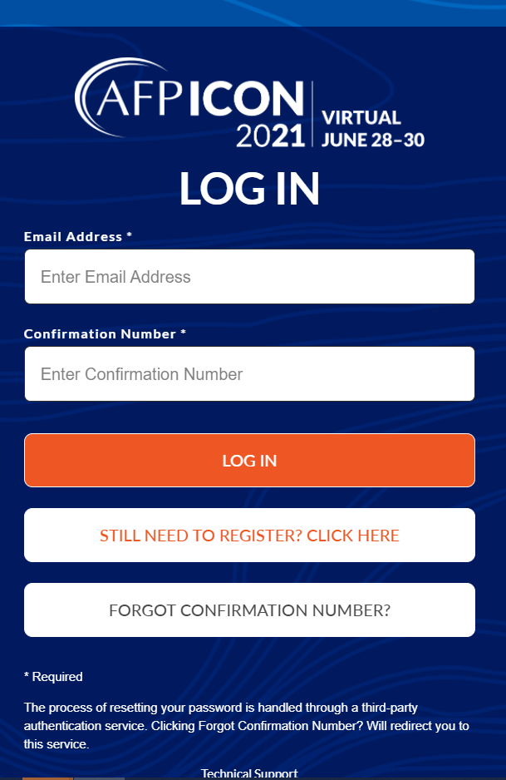
Accessing ICON Virtual
Confirmations re-sent to attendees include a link to the ICON Virtual
platform and instructions on logging in
Log in using the email used for your registration and the four-digit
“Confirmation ID” included in your confirmation
Attendees can log in starting today and can begin building personal
schedules and networking with other attendees

Slide 13
Technical Considerations
Tech support will be available during the event and prior to the event on Sunday, June 27 from 12:00 pm – 3:00 pm EDT
Recommended for attendees to log in prior to the day of the event and build your personal profile and log in 30 minutes early day of

Slide 14
Technical Considerations
Request your IT team to “Whitelist” the following platforms that will be used during ICON Virtual:
https://afpicon.onlineeventpro.freeman.com/
https://onlineeventapi.com
https://oepauthentication.azurewebsites.net
https://fileviewer.freemanco.com
https://eu.jotform.com/OEP_Support/freeman-virtual-support-portal
https://whereby.com/ Cdn.livestream.com
Api.new.livestream.com
playback2.akamaized.net/*
playback.akamaized.net/* livestream-f.akamaihd.net/*
secure-playlist.livestream.com/*
http://stream.io.api.com/
http://ladesk.com/
http://eum.appdynamics.com/

Slide 15
Platform Demonstration

Slide 16
THANK YOU!
Questions & Answers

