Slide 1
Welcome to AFP
Northeast Indiana Chapter
Membership Orientation

Slide 2
Reasons for Joining AFP
• Proclaim your professionalism
• Advertise your integrity
• Advance your career
• Further your cause
• Network with others who do what you do
• Advocate for your profession
• Serve your profession
• Utilize available resources
• Play a part in elevating the status of the fundraising profession

Slide 3
AFP International Overview
A professional association of individuals and organizations that generate philanthropic support for a wide variety of charitable institutions. Founded in 1960, AFP has 30,000 members in 240 chapters throughout the world.
• Promotes consistent and high standards of professional practice
• Requires members to comply with a Code of Ethical Principles and Standards
• Created and maintains A Donor Bill of Rights
• Supports legislation and regulations to encourage philanthropic giving and ethical fundraising
• Raises public awareness and interest in philanthropy

Slide 4
Networking opportunities with other fundraising professionals
Professional development through Certified Fund Raising Executive (CFRE) certification
Access to the AFP Fundraising Resource Center for information and research
Being a part of the largest professional fundraising organization in the world

Slide 5
Update/Complete Profile
Make sure to update your profile on your AFP account. This helps AFP Global know what training sessions to develop and have a better understanding of the needs of its members. Please do this whenever you change jobs!
Click on My Account
Then, My Name and Profile
Click Edit
Click Save

Slide 6
AFP NEin chapter
Leadership Development Opportunities
Committee Membership and Leadership
National Philanthropy Day Committee
Education Committee
IDEA (Inclusion, Diversity, Equity, and Access) Committee
Membership Committee
Communications Committee
Governance Committee

Slide 7
Volunteer Led
Our chapter is run solely by volunteers who are working full-time in the nonprofit sector, so if you have an interest in serving on one of our committees, please let us know and we will get you connected to the corresponding chairperson!

Slide 8
AFP NEin chapter
Dedicated to the Inclusion of All People and Diverse Leadership on committees and board of directors
Including members from arts & culture organizations
Including members from start-up causes
Including members reflecting the racial, gender, and cultural diversity of Northeast Indiana
Including members who can’t afford dues through scholarships and mentoring opportunities

Slide 9
AFP NEIn chapter
• Is an affiliate of AFP Global
• Offers chapter-sponsored guest speakers and educational workshops for professional development
• Sponsors an annual National Philanthropy Day celebration
• Provides scholarships and mentoring to its members
• Hosts a Job Board of local employment opportunities on its website, afpnein.org

Slide 10
AFPnein.org
Notes:
Our website is a powerful resource—especially enhanced for members.

Slide 11
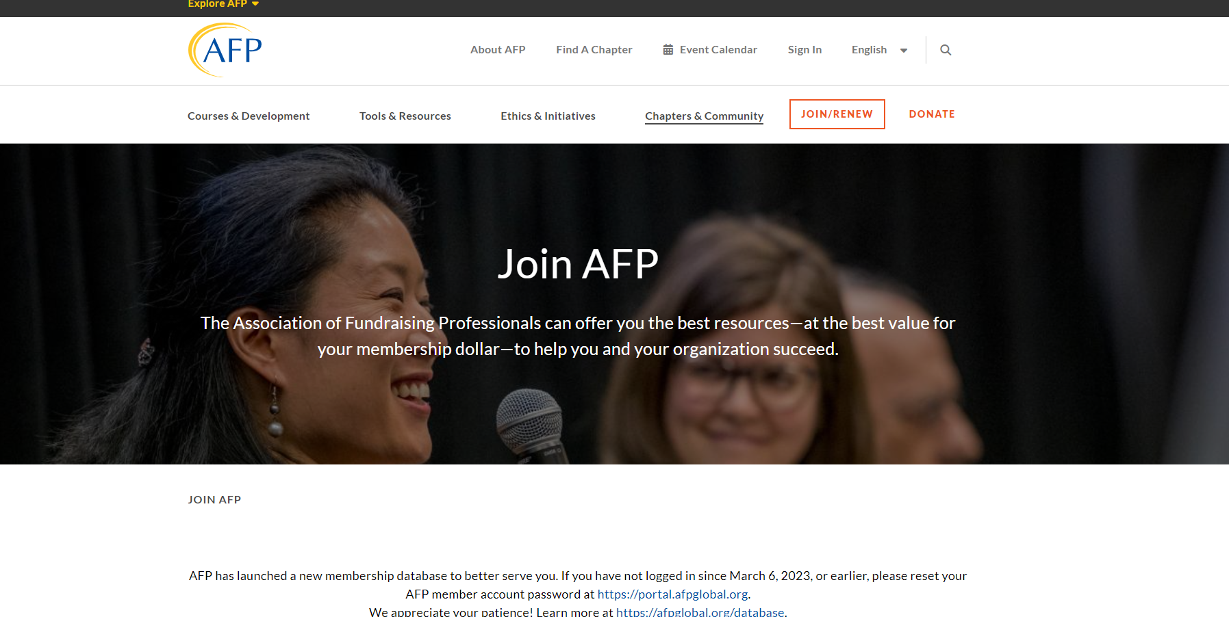
AFPglobal.org

Slide 12
AFPGLOBAL.org/online-learning

Slide 13
AFPGLOBAL.org/Fundraising-Dictionary

Slide 14
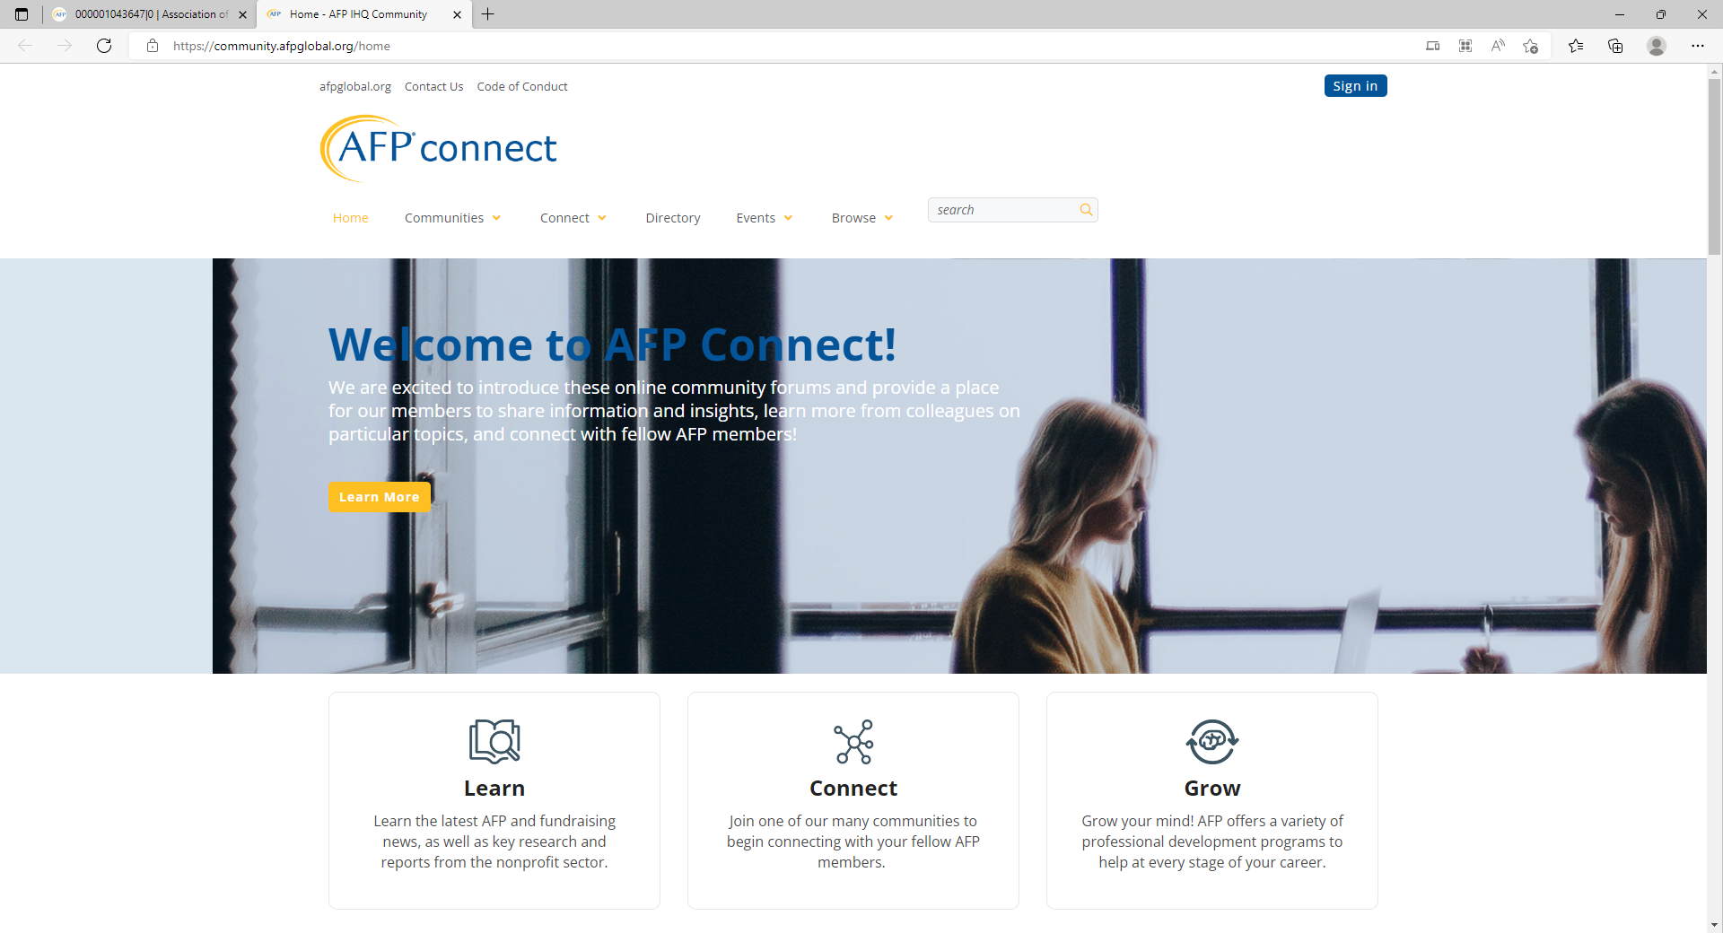
AFP Connect
Go to Home - AFP IHQ Community (afpglobal.org) to find community forums that are specific to you!

Slide 15
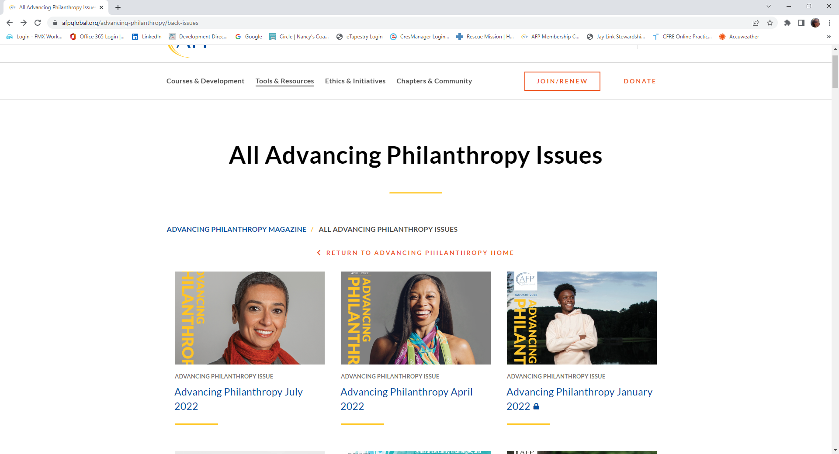
Advancing Philanthropy Magazine
AFP Global’s quarterly magazine is sent to all members. It is full of timely articles to help you succeed as a fundraiser!

Slide 16
Chapter contacts
Ashley Stoneburner, President
president@afpnein.org
Stacey Stumpf, President-Elect
education@afpnein.org
Colleen Dixon, Treasurer
treasurer@afpnein.org
Molly Graves, Secretary
secretary@afpnein.org
Rachel Burkholder, VP Communications
communications@afpnein.org
Melinda Perry, VP Governance
mperry@canterburyschool.org
Julie Goodwin, VP IDEA
julie.goodwin@cancer.org
Janelle Taylor & Mary Lasits, Membership Co-VPs
membership@afpnein.org

Slide 17
AFP Global Contacts
AFP Global Mailing Address: 4200 Wilson Boulevard, Suite 480, Arlington, VA 22203-4416 (U.S./Canada): +1 (800) 666-3863 Email: afp@afpglobal.org
Membership Department:
1-800-666-3863 or mbrship@afpglobal.org.
Nakera Dumas, Senior Director of Membership Nakera.Dumas@afpglobal.org
Tiffany Oglesby, Membership Data Specialist Tiffany.Oglesby@afpglobal.org
FYI—AFP Global handles membership renewals, not our chapter. If you have issues with your account, please reach out to Global and allow a few business days for a response.

Slide 18
Raising Fun Monthly Meetups!
11:30 am – 1:00 pm on FIRST THURSDAYS
Come and go as your schedule permits
Bring your lunch or enjoy one of the many local food merchants
Electric Works – Union Street Market:
Feb. 1st
March 7th
April 4th
May 2nd
Lunch on the Square:
June 6th
Happy 4th of July - NO RAISING FUN- Happy Independence Day!
August 1st
Electric Works – Union Street Market:
September 5th
October 3rd
November 7th
December 5th

